Slide 1
B-Trees
CMSC 420

Slide 2
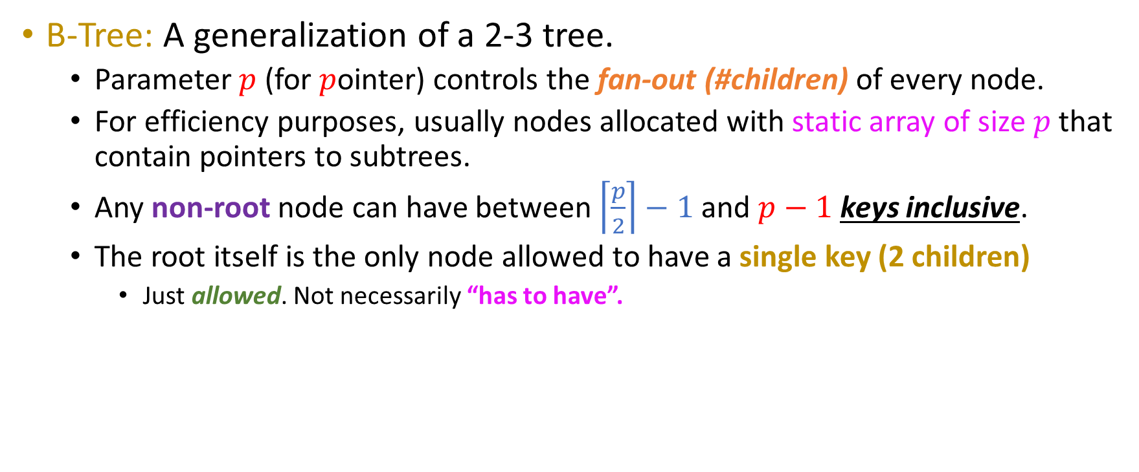
Improving our index
B-Tree: A generalization of a 2-3 tree.
Parameter $p$ (for $p$ointer) controls the fan-out (#children) of every node.
For efficiency purposes, usually nodes allocated with static array of size $p$ that contain pointers to subtrees.
Any non-root node can have between $\left\lceil \frac{p}{2}\right\rceil −1$ and $p−1$ keys inclusive.
The root itself is the only node allowed to have a single key (2 children)
Just allowed. Not necessarily “has to have”.

Slide 3
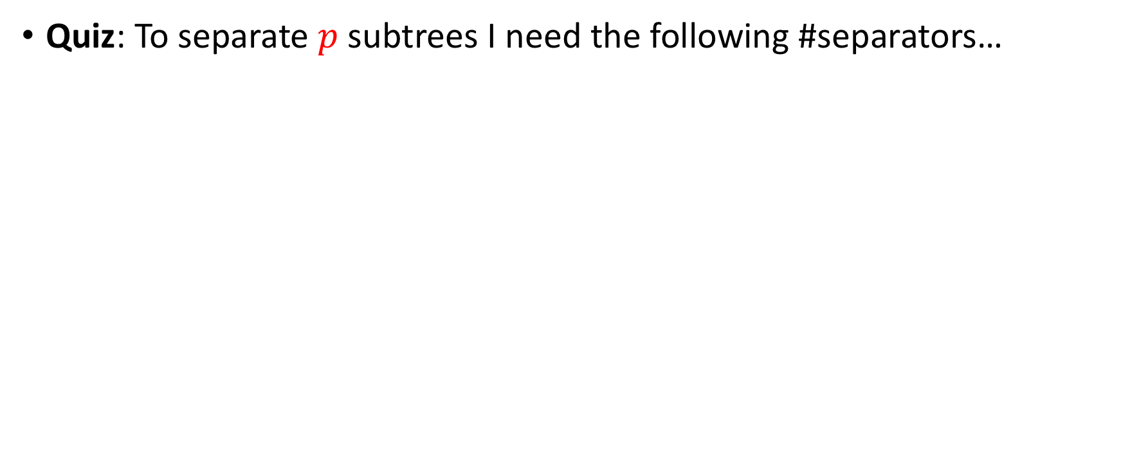
Next-level quiz
Quiz: To separate $p$ subtrees I need the following #separators…

Slide 4
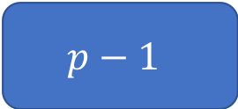
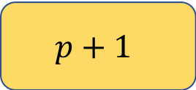

Next-level quiz
Quiz: To separate $p$ subtrees I need the following #separators…
$$p−1$$
$$p$$
$$p+1$$
Something else (what?)

Slide 5

Next-level quiz
Quiz: To separate $p$ subtrees I need the following #separators…
$$p−1$$
$$p$$
$$p+1$$
Something else (what?)
So, all B-Tree nodes have $(p−1)$ 4-byte separators and $p$ 8-byte pointers, for a total memory footprint of $12p −4=𝒪(p)$ each!

Slide 6
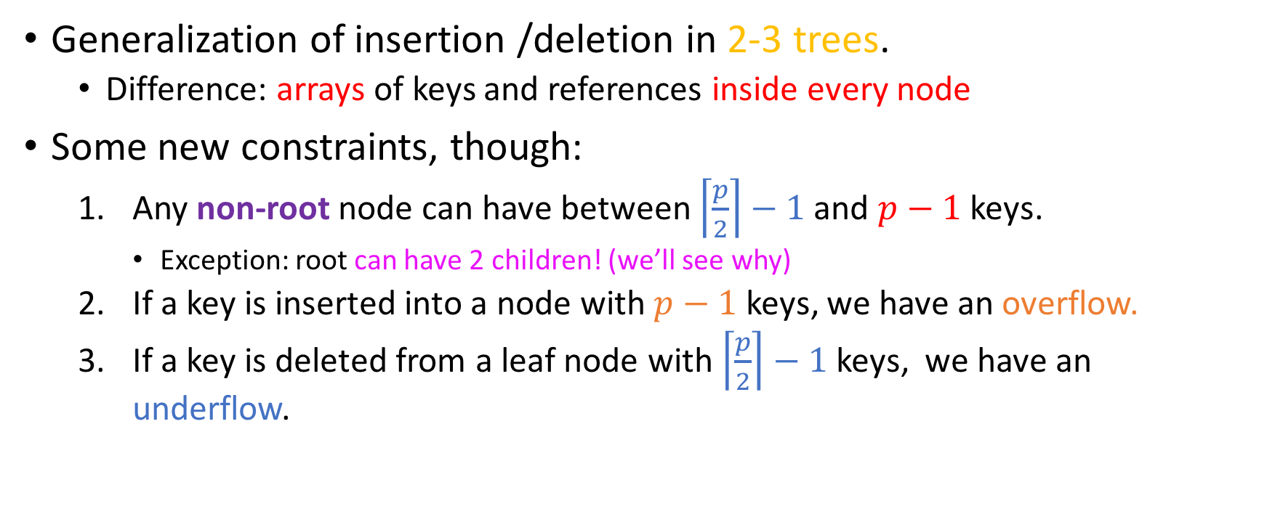
Insertion / Deletion into B-Trees
Generalization of insertion /deletion in 2-3 trees.
Difference: arrays of keys and references inside every node
Some new constraints, though:
Any non-root node can have between $\left\lceil \frac{p}{2}\right\rceil −1$ and $p−1$ keys.
Exception: root can have 2 children! (we’ll see why)
If a key is inserted into a node with $p−1$ keys, we have an overflow.
If a key is deleted from a leaf node with $\left\lceil \frac{p}{2}\right\rceil −1$ keys, we have an underflow.

Slide 7
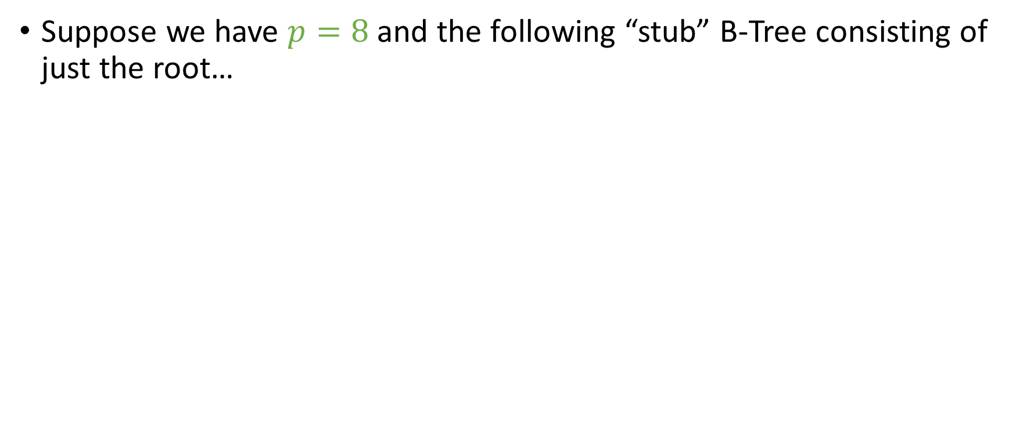
What’s with the constraint on the root?
Suppose we have $p=8$ and the following “stub” B-Tree consisting of just the root…
30, 36, 52, 67, 79, 90, 98

Slide 8
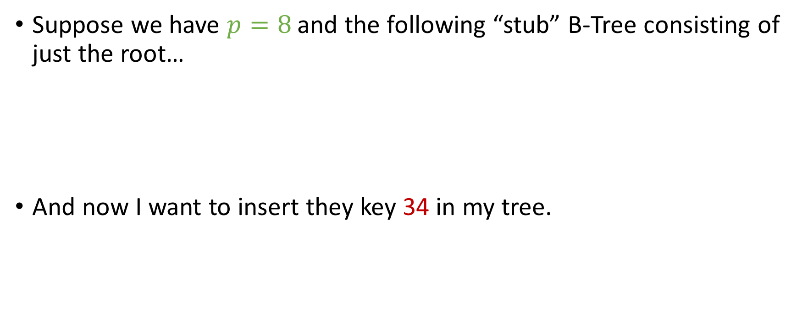
What’s with the constraint on the root?
Suppose we have $p=8$ and the following “stub” B-Tree consisting of just the root…
And now I want to insert they key 34 in my tree.
34
30, 36, 52, 67, 79, 90, 98

Slide 9

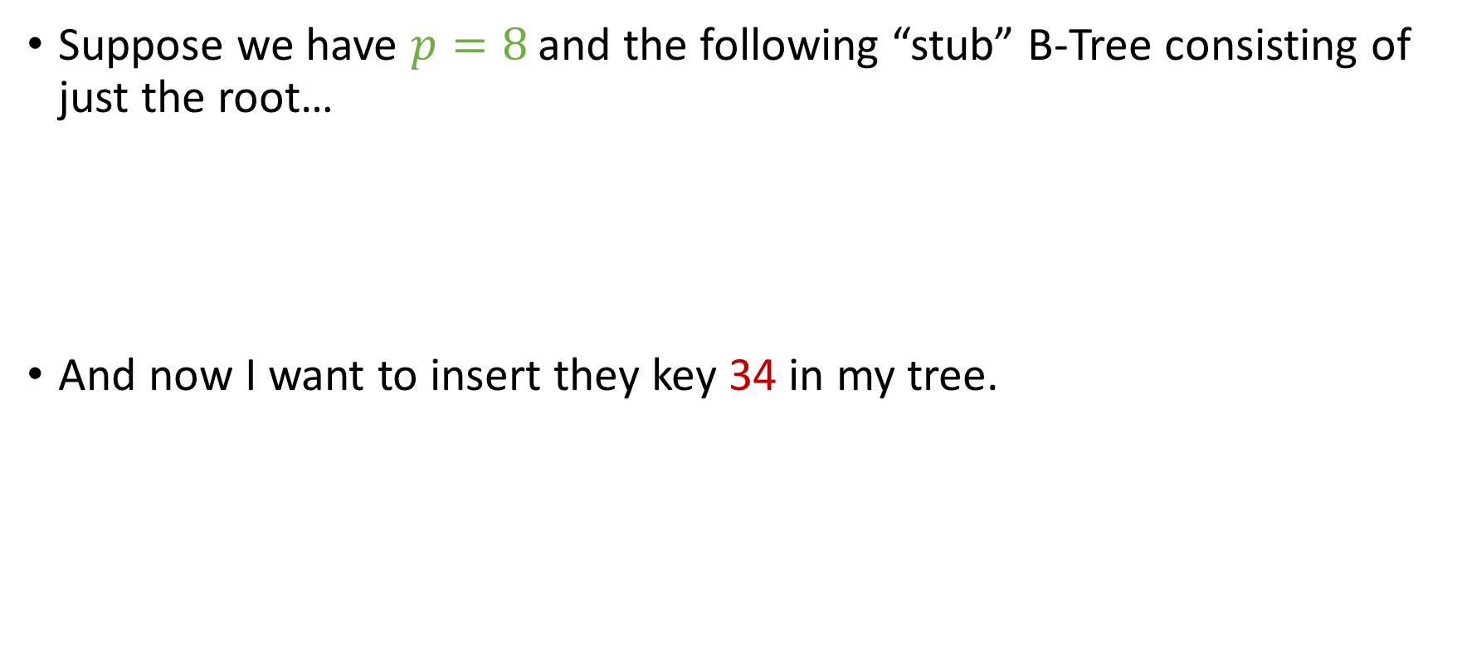
What’s with the constraint on the root?
Suppose we have $p=8$ and the following “stub” B-Tree consisting of just the root…
And now I want to insert they key 34 in my tree.
34
But I don’t appear to have any space….
30, 36, 52, 67, 79, 90, 98

Slide 10

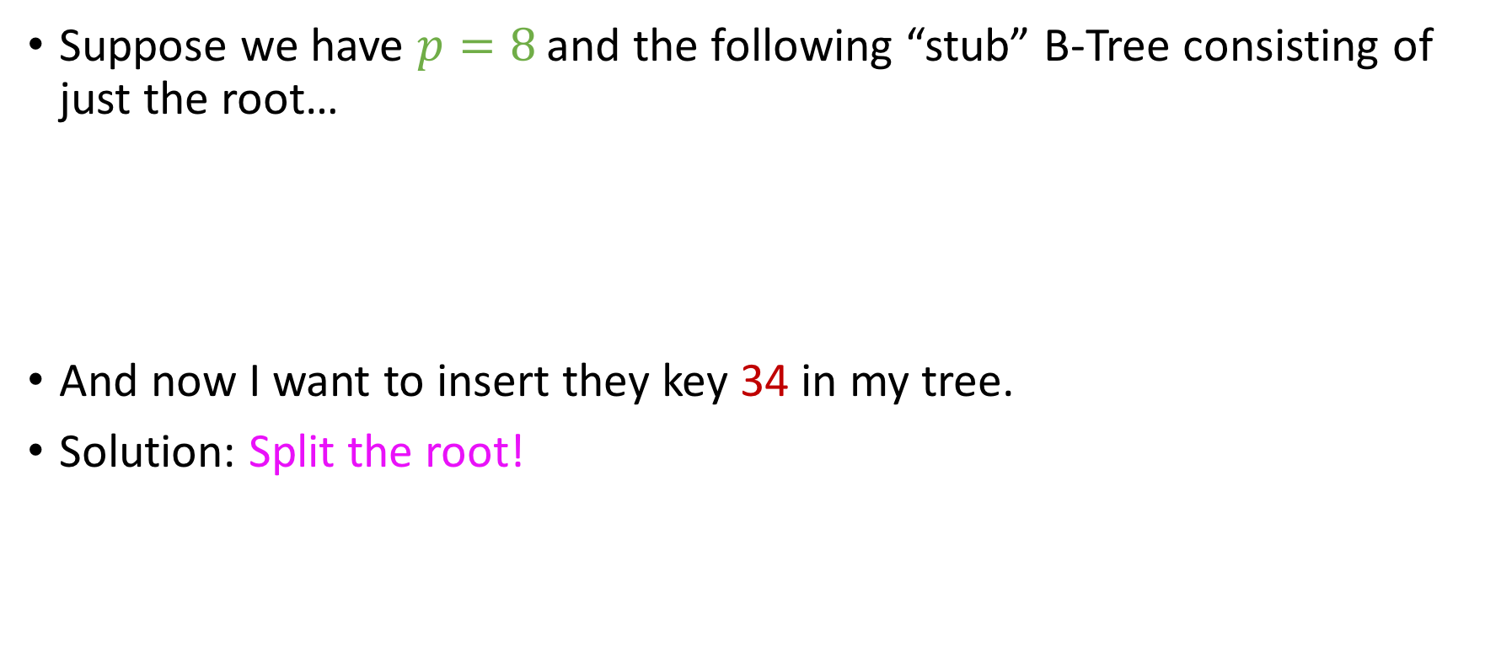
What’s with the constraints on root and leaves?
Suppose we have $p=8$ and the following “stub” B-Tree consisting of just the root…
And now I want to insert they key 34 in my tree.
Solution: Split the root!
34
30, 36, 52, 67, 79, 90, 98
Notes:
Tell the students that we will look at other cases shortly.

Slide 11
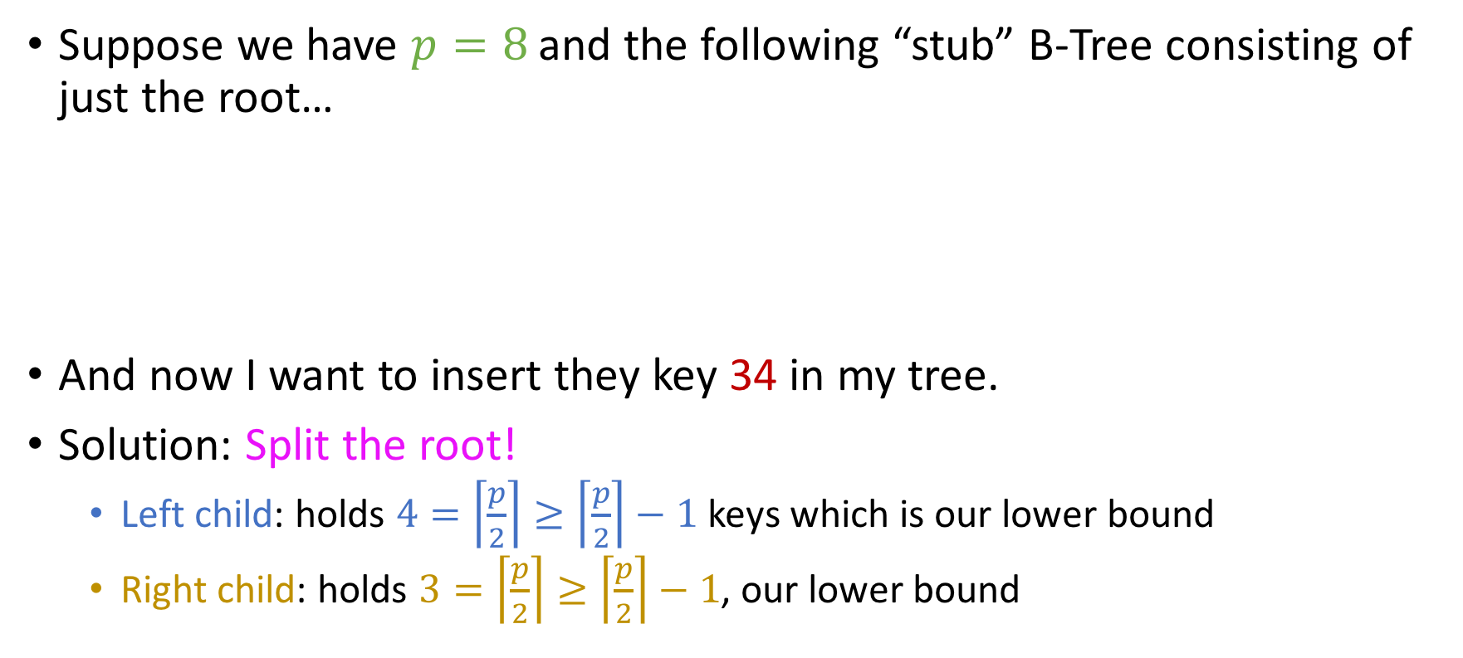
What’s with the constraints on root and leaves?
Suppose we have $p=8$ and the following “stub” B-Tree consisting of just the root…
And now I want to insert they key 34 in my tree.
Solution: Split the root!
Left child: holds $4=\left\lceil \frac{p}{2}\right\rceil ≥\left\lceil \frac{p}{2}\right\rceil −1$ keys which is our lower bound
Right child: holds $3=\left\lceil \frac{p}{2}\right\rceil ≥\left\lceil \frac{p}{2}\right\rceil −1$, our lower bound
67
30, 34, 36, 52
79, 90, 98

Slide 12
Dealing with overflows
Unlike in 2-3 trees, where splitting is practically the only option allowed, in B-trees, we will always attempt key rotations first.
To avoid asking the heap for large contiguous storage!

Slide 13
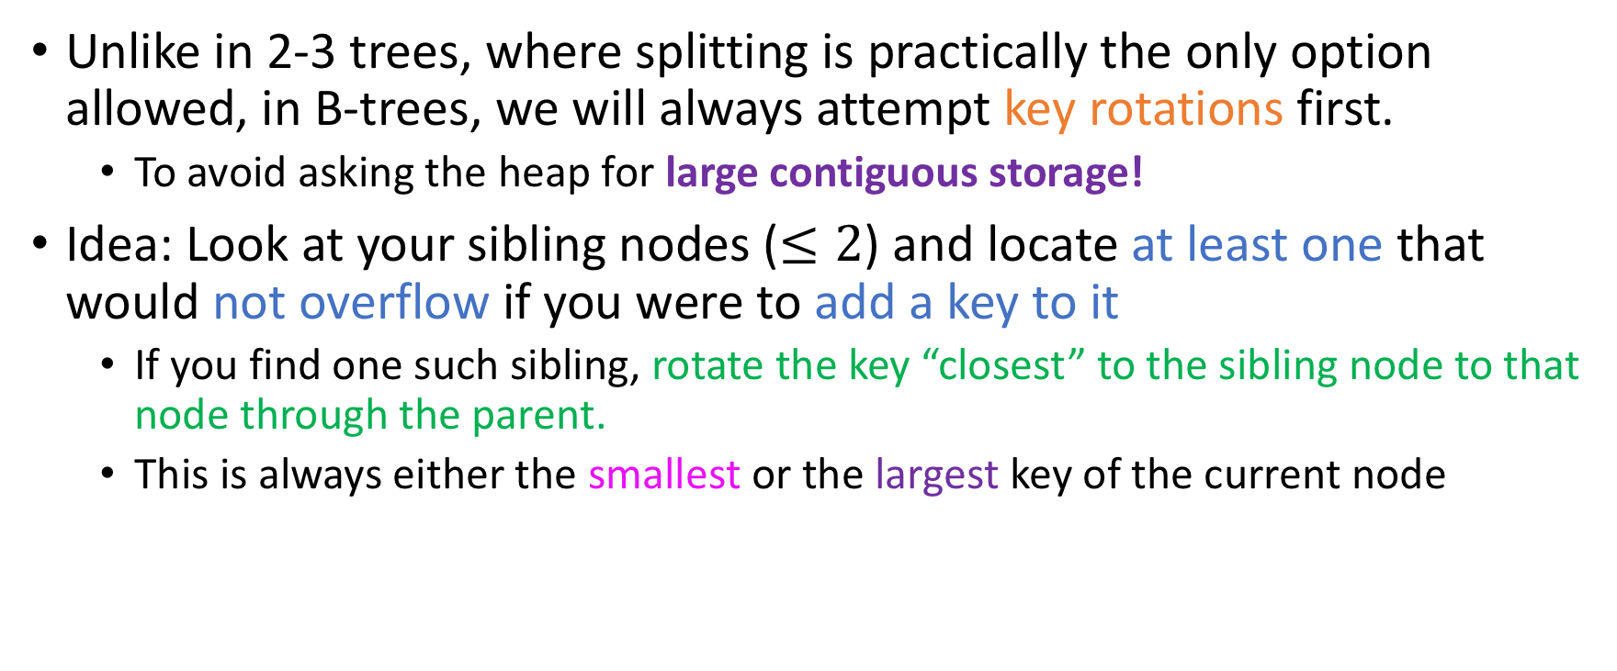
Dealing with overflows
Unlike in 2-3 trees, where splitting is practically the only option allowed, in B-trees, we will always attempt key rotations first.
To avoid asking the heap for large contiguous storage!
Idea: Look at your sibling nodes ($≤2$) and locate at least one that would not overflow if you were to add a key to it
If you find one such sibling, rotate the key “closest” to the sibling node to that node through the parent.
This is always either the smallest or the largest key of the current node

Slide 14
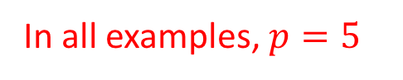
Example #0: No overflows
In all examples, $p=5$
57, 90, 162
-5, 6, 10, 34
60, 65, 70
100, 110, 120
179, 210, 300
-9, -6
-3, 0
8, 9
12, 29
39, 40
58, 59
62, 63, 64
66, 67
73,83, 88
92, 98
103, 108, 109
112, 114
124, 150
164, 168, 170, 176
185, 196
220, 240
314, 350, 400
Task: Insert 119

Slide 15
Example #0: No overflows
In all examples, $p=5$
57, 90, 162
-5, 6, 10, 34
60, 65, 70
100, 110, 120
179, 210, 300
-9, -6
-3, 0
8, 9
12, 29
39, 40
58, 59
62, 63, 64
66, 67
73,83, 88
92, 98
103, 108, 109
112, 114
124, 150
164, 168, 170, 176
185, 196
220, 240
314, 350, 400
Task: Insert 119

Slide 16
Example #0: No overflows
In all examples, $p=5$
57, 90, 162
-5, 6, 10, 34
60, 65, 70
100, 110, 120
179, 210, 300
-9, -6
-3, 0
8, 9
12, 29
39, 40
58, 59
62, 63, 64
66, 67
73,83, 88
92, 98
103, 108, 109
112, 114
124, 150
164, 168, 170, 176
185, 196
220, 240
314, 350, 400
Task: Insert 119

Slide 17
Example #0: No overflows
In all examples, $p=5$
57, 90, 162
-5, 6, 10, 34
60, 65, 70
100, 110, 120
179, 210, 300
-9, -6
-3, 0
8, 9
12, 29
39, 40
58, 59
62, 63, 64
66, 67
73,83, 88
92, 98
103, 108, 109
112, 114
124, 150
164, 168, 170, 176
185, 196
220, 240
314, 350, 400
Task: Insert 119

Slide 18
Example #0: No overflows
In all examples, $p=5$
57, 90, 162
-5, 6, 10, 34
60, 65, 70
100, 110, 120
179, 210, 300
-9, -6
-3, 0
8, 9
12, 29
39, 40
58, 59
62, 63, 64
66, 67
73,83, 88
92, 98
103, 108, 109
112, 114
124, 150
164, 168, 170, 176
185, 196
220, 240
314, 350, 400
Task: Insert 119

Slide 19
Example #0: No overflows
In all examples, $p=5$
57, 90, 162
-5, 6, 10, 34
60, 65, 70
100, 110, 120
179, 210, 300
-9, -6
-3, 0
8, 9
12, 29
39, 40
58, 59
62, 63, 64
66, 67
73,83, 88
92, 98
103, 108, 109
112, 114
124, 150
164, 168, 170, 176
185, 196
220, 240
314, 350, 400
Task: Insert 119

Slide 20
Example #0: No overflows
In all examples, $p=5$
57, 90, 162
-5, 6, 10, 34
60, 65, 70
100, 110, 120
179, 210, 300
-9, -6
-3, 0
8, 9
12, 29
39, 40
58, 59
62, 63, 64
66, 67
73,83, 88
92, 98
103, 108, 109
112, 114
124, 150
164, 168, 170, 176
185, 196
220, 240
314, 350, 400
Task: Insert 119

Slide 21
Example #0: No overflows
In all examples, $p=5$
57, 90, 162
-5, 6, 10, 34
60, 65, 70
100, 110, 120
179, 210, 300
-9, -6
-3, 0
8, 9
12, 29
39, 40
58, 59
62, 63, 64
66, 67
73,83, 88
92, 98
103, 108, 109
112, 114
124, 150
164, 168, 170, 176
185, 196
220, 240
314, 350, 400
Task: Insert 119

Slide 22
Example #0: No overflows
In all examples, $p=5$
57, 90, 162
-5, 6, 10, 34
60, 65, 70
100, 110, 120
179, 210, 300
-9, -6
-3, 0
8, 9
12, 29
39, 40
58, 59
62, 63, 64
66, 67
73,83, 88
92, 98
103, 108, 109
112, 114, 119
124, 150
164, 168, 170, 176
185, 196
220, 240
314, 350, 400
Task: Insert 119

Slide 23

Example #0: No overflows
In all examples, $p=5$
57, 90, 162
-5, 6, 10, 34
60, 65, 70
100, 110, 120
179, 210, 300
-9, -6
-3, 0
8, 9
12, 29
39, 40
58, 59
62, 63, 64
66, 67
73,83, 88
92, 98
103, 108, 109
112, 114, 119
124, 150
164, 168, 170, 176
185, 196
220, 240
314, 350, 400
Task: Insert 119
No overflow at the leaf, so no problem

Slide 24
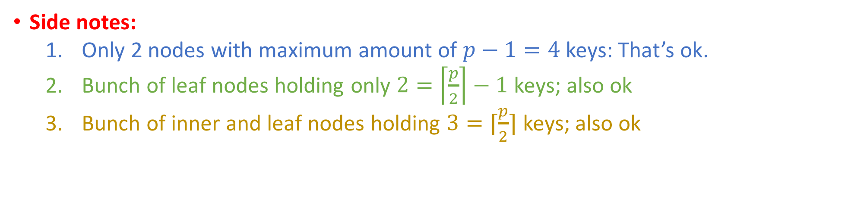
Example #0: No overflows
In all examples, $p=5$
57, 90, 162
-5, 6, 10, 34
60, 65, 70
100, 110, 120
179, 210, 300
-9, -6
-3, 0
8, 9
12, 29
39, 40
58, 59
62, 63, 64
66, 67
73,83, 88
92, 98
103, 108, 109
112, 114, 119
124, 150
164, 168, 170, 176
185, 196
220, 240
314, 350, 400
Side notes:
Only 2 nodes with maximum amount of $p−1=4$ keys: That’s ok.
Bunch of leaf nodes holding only $2=\left\lceil \frac{p}{2}\right\rceil −1$ keys; also ok
Bunch of inner and leaf nodes holding $3=⌈\frac{p}{2}⌉$ keys; also ok

Slide 25
Example #1: Pick either sibling
57, 90, 162
-5, 6, 10, 34
60, 65, 70
100, 110, 120
179, 210, 300
-9, -6
-3, 0, 1, 3
8, 9
12, 29
39, 40
58, 59
62, 63, 64
66, 67
73,83, 88
92, 98
103, 108, 109
112, 114
124, 150
164, 168, 170, 176
185, 196
220, 240
314, 350, 400
Task: Insert -1

Slide 26
Example #1: Pick either sibling
57, 90, 162
-5, 6, 10, 34
60, 65, 70
100, 110, 120
179, 210, 300
-9, -6
-3, 0, 1, 3
8, 9
12, 29
39, 40
58, 59
62, 63, 64
66, 67
73,83, 88
92, 98
103, 108, 109
112, 114
124, 150
164, 168, 170, 176
185, 196
220, 240
314, 350, 400
Task: Insert -1

Slide 27
Example #1: Pick either sibling
57, 90, 162
-5, 6, 10, 34
60, 65, 70
100, 110, 120
179, 210, 300
-9, -6
-3, 0, 1, 3
8, 9
12, 29
39, 40
58, 59
62, 63, 64
66, 67
73,83, 88
92, 98
103, 108, 109
112, 114
124, 150
164, 168, 170, 176
185, 196
220, 240
314, 350, 400
Task: Insert -1

Slide 28
Example #1: Pick either sibling
57, 90, 162
-5, 6, 10, 34
60, 65, 70
100, 110, 120
179, 210, 300
-9, -6
-3, 0, 1, 3
8, 9
12, 29
39, 40
58, 59
62, 63, 64
66, 67
73,83, 88
92, 98
103, 108, 109
112, 114
124, 150
164, 168, 170, 176
185, 196
220, 240
314, 350, 400
Task: Insert -1

Slide 29
Example #1: Pick either sibling
57, 90, 162
-5, 6, 10, 34
60, 65, 70
100, 110, 120
179, 210, 300
-9, -6
-3, 0, 1, 3
8, 9
12, 29
39, 40
58, 59
62, 63, 64
66, 67
73,83, 88
92, 98
103, 108, 109
112, 114
124, 150
164, 168, 170, 176
185, 196
220, 240
314, 350, 400
Task: Insert -1

Slide 30
Example #1: Pick either sibling
57, 90, 162
-5, 6, 10, 34
60, 65, 70
100, 110, 120
179, 210, 300
-9, -6
-3, 0, 1, 3
8, 9
12, 29
39, 40
58, 59
62, 63, 64
66, 67
73,83, 88
92, 98
103, 108, 109
112, 114
124, 150
164, 168, 170, 176
185, 196
220, 240
314, 350, 400
Task: Insert -1

Slide 31
Example #1: Pick either sibling
57, 90, 162
-5, 6, 10, 34
60, 65, 70
100, 110, 120
179, 210, 300
-9, -6
-3, 0, 1, 3
8, 9
12, 29
39, 40
58, 59
62, 63, 64
66, 67
73,83, 88
92, 98
103, 108, 109
112, 114
124, 150
164, 168, 170, 176
185, 196
220, 240
314, 350, 400
Task: Insert -1

Slide 32
Example #1: Pick either sibling
57, 90, 162
-5, 6, 10, 34
60, 65, 70
100, 110, 120
179, 210, 300
-9, -6
-3, 0, 1, 3
8, 9
12, 29
39, 40
58, 59
62, 63, 64
66, 67
73,83, 88
92, 98
103, 108, 109
112, 114
124, 150
164, 168, 170, 176
185, 196
220, 240
314, 350, 400
Task: Insert -1

Slide 33
Example #1: Pick either sibling
57, 90, 162
-5, 6, 10, 34
60, 65, 70
100, 110, 120
179, 210, 300
-9, -6
-3, 0, 1, 3
8, 9
12, 29
39, 40
58, 59
62, 63, 64
66, 67
73,83, 88
92, 98
103, 108, 109
112, 114
124, 150
164, 168, 170, 176
185, 196
220, 240
314, 350, 400
Task: Insert -1

Slide 34
Example #1: Pick either sibling
57, 90, 162
-5, 6, 10, 34
60, 65, 70
100, 110, 120
179, 210, 300
-9, -6
-3, 0, 1, 3
8, 9
12, 29
39, 40
58, 59
62, 63, 64
66, 67
73,83, 88
92, 98
103, 108, 109
112, 114
124, 150
164, 168, 170, 176
185, 196
220, 240
314, 350, 400
Task: Insert -1

Slide 35
Example #1: Pick either sibling
57, 90, 162
-5, 6, 10, 34
60, 65, 70
100, 110, 120
179, 210, 300
-9, -6
-3, 0, 1, 3
8, 9
12, 29
39, 40
58, 59
62, 63, 64
66, 67
73,83, 88
92, 98
103, 108, 109
112, 114
124, 150
164, 168, 170, 176
185, 196
220, 240
314, 350, 400
Task: Insert -1

Slide 36

Example #1: Pick either sibling
57, 90, 162
-5, 6, 10, 34
60, 65, 70
100, 110, 120
179, 210, 300
-9, -6
-3, -1, 0, 1, 3
8, 9
12, 29
39, 40
58, 59
62, 63, 64
66, 67
73,83, 88
92, 98
103, 108, 109
112, 114
124, 150
164, 168, 170, 176
185, 196
220, 240
314, 350, 400
Task: Insert -1
Overflow ☹

Slide 37

Example #1: Pick either sibling
57, 90, 162
-5, 6, 10, 34
60, 65, 70
100, 110, 120
179, 210, 300
-9, -6
-3, -1, 0, 1, 3
8, 9
12, 29
39, 40
58, 59
62, 63, 64
66, 67
73,83, 88
92, 98
103, 108, 109
112, 114
124, 150
164, 168, 170, 176
185, 196
220, 240
314, 350, 400
Task: Insert -1
No worries! I can rotate to either sibling ☺

Slide 38
Example #1: Pick either sibling
57, 90, 162
-5, 6, 10, 34
60, 65, 70
100, 110, 120
179, 210, 300
-9, -6
-3, -1, 0, 1, 3
8, 9
12, 29
39, 40
58, 59
62, 63, 64
66, 67
73,83, 88
92, 98
103, 108, 109
112, 114
124, 150
164, 168, 170, 176
185, 196
220, 240
314, 350, 400
Task: Insert -1
E.g pick right sibling, rotate 3 rightwards
(This is a remnant from an older semester: In Fall 19, we make the convention of rotation rightwards first)

Slide 39
Example #1: Pick either sibling
57, 90, 162
-5, 3, 10, 34
60, 65, 70
100, 110, 120
179, 210, 300
-9, -6
-3,-1, 0, 1
6, 8, 9
12, 29
39, 40
58, 59
62, 63, 64
66, 67
73,83, 88
92, 98
103, 108, 109
112, 114
124, 150
164, 168, 170, 176
185, 196
220, 240
314, 350, 400
Task: Insert -1
Careful: This means that the parent’s key (6) is the one that lands on the sibling node… 3 goes to the parent!

Slide 40
Example #1: Pick either sibling
57, 90, 162
-3, 6, 10, 34
60, 65, 70
100, 110, 120
179, 210, 300
-9, -6,
-5
-1, 0, 1, 3
8, 9
12, 29
39, 40
58, 59
62, 63, 64
66, 67
73,83, 88
92, 98
103, 108, 109
112, 114
124, 150
164, 168, 170, 176
185, 196
220, 240
314, 350, 400
Task: Insert -1
Overflow fixed, key inserted ☺

Slide 41
Example #2: Only one sibling with space!
57, 90, 162
-3, 6, 10, 34
60, 65, 70
100, 110, 120
179, 210, 300
-9, -6,
-5
-1, 0, 1, 3
8, 9
12, 29
39, 40
58, 59
62, 63, 64
66, 67
73,83, 88
92, 98
103, 108, 109
112, 114
124, 150
164, 168, 170, 176
185, 196, 200, 207
220, 240
314, 350, 400
Let’s add some more keys here to make this insertion interesting….
Task: Insert 205

Slide 42
Example #2: Only one sibling with space!
57, 90, 162
-3, 6, 10, 34
60, 65, 70
100, 110, 120
179, 210, 300
-9, -6,
-5
-1, 0, 1, 3
8, 9
12, 29
39, 40
58, 59
62, 63, 64
66, 67
73,83, 88
92, 98
103, 108, 109
112, 114
124, 150
164, 168, 170, 176
185, 196, 200,
205 207
220, 240
314, 350, 400
Overflow…

Slide 43
Example #2: Only one sibling with space!
57, 90, 162
-3, 6, 10, 34
60, 65, 70
100, 110, 120
179, 210, 300
-9, -6,
-5
-1, 0, 1, 3
8, 9
12, 29
39, 40
58, 59
62, 63, 64
66, 67
73,83, 88
92, 98
103, 108, 109
112, 114
124, 150
164, 168, 170, 176
185, 196, 200,
205 207
220, 240
314, 350, 400
Overflow…
Can’t rotate 185 leftwards because left sibling full ☹

Slide 44
Example #2: Only one sibling with space!
57, 90, 162
-3, 6, 10, 34
60, 65, 70
100, 110, 120
179, 210, 300
-9, -6,
-5
-1, 0, 1, 3
8, 9
12, 29
39, 40
58, 59
62, 63, 64
66, 67
73,83, 88
92, 98
103, 108, 109
112, 114
124, 150
164, 168, 170, 176
185, 196, 200,
205 207
220, 240
314, 350, 400
Overflow…
Can’t rotate 185 leftwards because left sibling full ☹
But can rotate 207 rightwards because right sibling non-full ☺
Once again, for Fall 19, we would make the convention of going right first (so we would check it first).

Slide 45
Example #2: Only one sibling with space!
57, 90, 162
-3, 6, 10, 34
60, 65, 70
100, 110, 120
179, 207, 300
-9, -6,
-5
-1, 0, 1, 3
8, 9
12, 29
39, 40
58, 59
62, 63, 64
66, 67
73,83, 88
92, 98
103, 108, 109
112, 114
124, 150
164, 168, 170, 176
185, 196, 200,
205
210,
220, 240
314, 350, 400
Overflow…
Can’t rotate 185 leftwards because left sibling full ☹
But can rotate 207 rightwards because right sibling non-full ☺

Slide 46
Example #3: Examine first sibling node!
57, 90, 162
-3, 6, 10, 34
60, 65, 70
100, 110, 120
179, 207, 300
-9, -6,
-5
-1, 0, 1, 3
8, 9
12, 29
39, 40
58, 59
62, 63, 64
66, 67
73,83, 88
92, 98
103, 108, 109
112, 114
124, 150
164, 168, 170, 176
185, 196, 200,
205
210,
220, 240
314, 350, 400
Task: Insert 178

Slide 47
Example #3: Examine first sibling node!
57, 90, 162
-3, 6, 10, 34
60, 65, 70
100, 110, 120
179, 207, 300
-9, -6,
-5
-1, 0, 1, 3
8, 9
12, 29
39, 40
58, 59
62, 63, 64
66, 67
73,83, 88
92, 98
103, 108, 109
112, 114
124, 150
164, 168, 170, 176, 178
185, 196, 200,
205
210,
220, 240
314, 350, 400
Task: Insert 178
Overflow… ☹
Only sibling also full ☹

Slide 48
Example #3: Examine first sibling node!
57, 90, 162
-3, 6, 10, 34
60, 65, 70
100, 110, 120
178, 205, 300
-9, -6,
-5
-1, 0, 1, 3
8, 9
12, 29
39, 40
58, 59
62, 63, 64
66, 67
73,83, 88
92, 98
103, 108, 109
179, 185, 196, 200,
112, 114
124, 150
164, 168, 170, 176
207,
210,
220, 240
314, 350, 400
Task: Insert 178
Overflow… ☹
Only sibling also full ☹
Solution: Rotate 205 rightwards and 178 (new key!) rightwards! ☺

Slide 49
Example #3: Examine first sibling node!
57, 90, 162
-3, 6, 10, 34
60, 65, 70
100, 110, 120
178, 205, 300
-9, -6,
-5
-1, 0, 1, 3
8, 9
12, 29
39, 40
58, 59
62, 63, 64
66, 67
73,83, 88
92, 98
103, 108, 109
179, 185, 196, 200,
112, 114
124, 150
164, 168, 170, 176
207,
210,
220, 240
314, 350, 400
Task: Insert 174

Slide 50
Example #3: Examine first sibling node!
57, 90, 162
-3, 6, 10, 34
60, 65, 70
100, 110, 120
178, 205, 300
-9, -6,
-5
-1, 0, 1, 3
8, 9
12, 29
39, 40
58, 59
62, 63, 64
66, 67
73,83, 88
92, 98
103, 108, 109
179, 185, 196, 200,
112, 114
124, 150
164, 168, 170, 174, 176
207,
210,
220, 240
314, 350, 400
Task: Insert 174
Overflow ☹

Slide 51
Example #3: Examine first sibling node!
57, 90, 162
-3, 6, 10, 34
60, 65, 70
100, 110, 120
178, 205, 300
-9, -6,
-5
-1, 0, 1, 3
8, 9
12, 29
39, 40
58, 59
62, 63, 64
66, 67
73,83, 88
92, 98
103, 108, 109
179, 185, 196, 200,
112, 114
124, 150
164, 168, 170, 174, 176
207,
210,
220, 240
314, 350, 400
Task: Insert 174
Overflow ☹
1st and 2nd sibling don’t have space to rotate keys to ☹

Slide 52

Example #4: Examine second sibling node!
57, 90, 162
-3, 6, 10, 34
60, 65, 70
100, 110, 120
178, 205, 300
-9, -6,
-5
-1, 0, 1, 3
8, 9
12, 29
39, 40
58, 59
62, 63, 64
66, 67
73,83, 88
92, 98
103, 108, 109
179, 185, 196, 200,
112, 114
124, 150
164, 168, 170, 174, 176
207,
210,
220, 240
314, 350, 400
Task: Insert 174
Overflow ☹
1st and 2nd sibling don’t have space to rotate keys to ☹
But 3rd sibling does! ☺

Slide 53

Example #4: Examine second sibling node!
57, 90, 162
-3, 6, 10, 34
60, 65, 70
100, 110, 120
176, 200, 240
-9, -6,
-5
-1, 0, 1, 3
8, 9
12, 29
39, 40
58, 59
62, 63, 64
66, 67
73,83, 88
92, 98
103, 108, 109
178,
179, 185, 196
112, 114
124, 150
164, 168, 170, 174
205,
207,
210,
220
300, 314, 350, 400
Task: Insert 174
Overflow ☹
1st and 2nd sibling don’t have space to rotate keys to ☹
But 3rd sibling does! ☺
WE INTERRUPT YOUR REGULARLY SCHEDULED PROGRAM FOR AN INVESTIGATION INTO SIBLING SEARCH!

Slide 54
So, should I always rotate as far away as I can?

Slide 55
So, should I always rotate as far away as I can?
UNCLEAR.

Slide 56
So, should I always rotate as far away as I can?
UNCLEAR.
In the 70s and 80s, yes, absolutely
Memory expensive: inner nodes in disk as well means we want to minimize height.

Slide 57
So, should I always rotate as far away as I can?
UNCLEAR.
In the 70s and 80s, yes, absolutely
Memory expensive: inner nodes in disk as well means we want to minimize height.
Nowadays, can fit the index (B-Tree) in memory.
So might not care about adding to the height that much

Slide 58
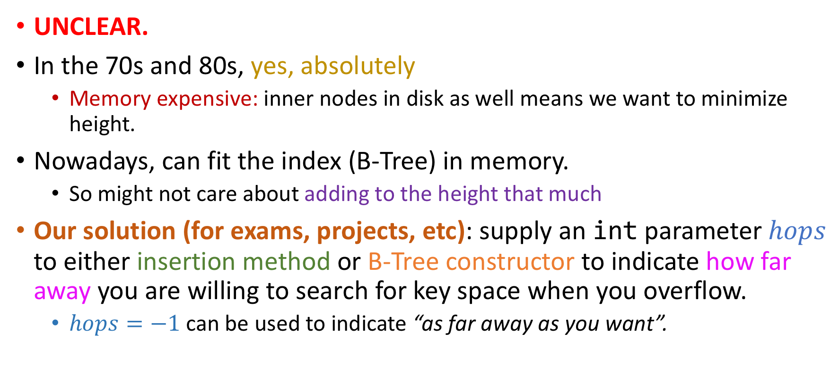
So, should I always rotate as far away as I can?
UNCLEAR.
In the 70s and 80s, yes, absolutely
Memory expensive: inner nodes in disk as well means we want to minimize height.
Nowadays, can fit the index (B-Tree) in memory.
So might not care about adding to the height that much
Our solution (for exams, projects, etc): supply an int parameter $hops$ to either insertion method or B-Tree constructor to indicate how far away you are willing to search for key space when you overflow.
$hops=−1$ can be used to indicate “as far away as you want”.

Slide 59
Example #5: Splitting, parent has space
57, 90, 162
-3, 6, 10, 34
60, 65, 70
100, 110, 120
176, 200, 240
-9, -6,
-5
-1, 0, 1, 3
8, 9
12, 29
39, 40
58, 59
62, 63, 64
66, 67
73,83, 88
92, 98
103, 108, 109
178,
179, 185, 196
112, 114
124, 150
164, 168, 170, 174
205,
207,
210,
220
300, 314, 350, 400
Task: Insert 181

Slide 60
Example #5: Splitting, parent has space
57, 90, 162
-3, 6, 10, 34
60, 65, 70
100, 110, 120
176, 200, 240
-9, -6,
-5
-1, 0, 1, 3
8, 9
12, 29
39, 40
58, 59
62, 63, 64
66, 67
73,83, 88
92, 98
103, 108, 109
178,
179, 181, 185, 196
112, 114
124, 150
164, 168, 170, 174
205,
207,
210,
220
300, 314, 350, 400
Task: Insert 181
Overflow ☹

Slide 61

Example #5: Splitting, parent has space
57, 90, 162
-3, 6, 10, 34
60, 65, 70
100, 110, 120
176, 200, 240
-9, -6,
-5
-1, 0, 1, 3
8, 9
12, 29
39, 40
58, 59
62, 63, 64
66, 67
73,83, 88
92, 98
103, 108, 109
178,
179, 181, 185, 196
112, 114
124, 150
164, 168, 170, 174
205,
207,
210,
220
300, 314, 350, 400
Task: Insert 181
Overflow ☹
No sibling or cousin has space for rotating keys to! ☹

Slide 62

Example #5: Splitting, parent has space
57, 90, 162
-3, 6, 10, 34
60, 65, 70
100, 110, 120
176, 181, 200, 240
-9, -6,
-5
-1, 0, 1, 3
8, 9
12, 29
39, 40
58, 59
62, 63, 64
66, 67
73,83, 88
92, 98
103, 108, 109
205,
207,
210,
220
300, 314, 350, 400
112, 114
124, 150
164, 168, 170, 174
178,
179
185, 196
Task: Insert 181
Overflow ☹
No sibling or cousin has space for rotating keys to! ☹
Solution: Split the current node, and elevate middle key to the parent ☺

Slide 63
Example #5: Splitting, parent has space
57, 90, 162
-3, 6, 10, 34
60, 65, 70
100, 110, 120
176, 181, 200, 240
-9, -6,
-5
-1, 0, 1, 3
8, 9
12, 29
39, 40
58, 59
62, 63, 64
66, 67
73,83, 88
92, 98
103, 108, 109
205,
207,
210,
220
300, 314, 350, 400
112, 114
124, 150
164, 168, 170, 174
178,
179
185, 196
Task: Insert 181
Overflow ☹
No sibling or cousin has space for rotating keys to! ☹
Solution: Split the current node, and elevate middle key to the parent ☺
Parent has 1 additional child subtree now.

Slide 64
Interesting notes about splitting
57, 90, 162
-3, 6, 10, 34
60, 65, 70
100, 110, 120
176, 181, 200, 240
-9, -6,
-5
-1, 0, 1, 3
8, 9
12, 29
39, 40
58, 59
62, 63, 64
66, 67
73,83, 88
92, 98
103, 108, 109
205,
207,
210,
220
300, 314, 350, 400
112, 114
124, 150
164, 168, 170, 174
178,
179
185, 196
4 key insertions in the range [177, 199] will be solvable with key rotations to the left or right!
Point: when a splitting in a certain range occurs, it’s unlikely to happen again in the near future (locality of reference)

Slide 65
Example #6: Splitting, parent overflows and rotates
57, 90, 162
-3, 6, 10, 34
60, 65, 70
100, 110, 120
176, 181, 200, 240
-9, -6,
-5
-1, 0, 1, 3
8, 9
12, 29
39, 40
58, 59
62, 63, 64
66, 67
73,83, 88
92, 98
103, 108, 109
205,
207,
210,
220
300, 314, 350, 400
112, 114
124, 150
164, 168, 170, 174
177, 178,
179,
180
185, 187, 196,
197
Added some keys here to make example interesting…

Slide 66
Example #6: Splitting, parent overflows and rotates
57, 90, 162
-3, 6, 10, 34
60, 65, 70
100, 110, 120
176, 181, 200, 240
-9, -6,
-5
-1, 0, 1, 3
8, 9
12, 29
39, 40
58, 59
62, 63, 64
66, 67
73,83, 88
92, 98
103, 108, 109
205,
207,
210,
220
300, 314, 350, 400
112, 114
124, 150
164, 168, 170, 174
177, 178,
179,
180
185, 187, 196,
197
Task: Insert 190

Slide 67

Example #6: Splitting, parent overflows and rotates
57, 90, 162
-3, 6, 10, 34
60, 65, 70
100, 110, 120
176, 181, 200, 240
-9, -6,
-5
-1, 0, 1, 3
8, 9
12, 29
39, 40
58, 59
62, 63, 64
66, 67
73,83, 88
92, 98
103, 108, 109
205,
207,
210,
220
300, 314, 350, 400
112, 114
124, 150
164, 168, 170, 174
177, 178,
179,
180
185, 187, 190, 196,
197
Task: Insert 190
Overflow ☹

Slide 68

Example #6: Splitting, parent overflows and rotates
57, 90, 162
-3, 6, 10, 34
60, 65, 70
100, 110, 120
176, 181, 200, 240
-9, -6,
-5
-1, 0, 1, 3
8, 9
12, 29
39, 40
58, 59
62, 63, 64
66, 67
73,83, 88
92, 98
103, 108, 109
205,
207,
210,
220
300, 314, 350, 400
112, 114
124, 150
164, 168, 170, 174
177, 178,
179,
180
185, 187, 190, 196,
197
Task: Insert 190
Overflow ☹
1st Siblings, 2nd siblings and parent all full! ☹
WTF MAN

Slide 69
Example #6: Splitting, parent overflows and rotates
57, 90, 162
-3, 6, 10, 34
60, 65, 70
100, 110, 120
176, 181, 200, 240
-9, -6,
-5
-1, 0, 1, 3
8, 9
12, 29
39, 40
58, 59
62, 63, 64
66, 67
73,83, 88
92, 98
103, 108, 109
205,
207,
210,
220
300, 314, 350, 400
112, 114
124, 150
164, 168, 170, 174
177, 178,
179,
180
185, 187, 190, 196,
197
Task: Insert 190
Overflow ☹
1st Siblings, 2nd siblings and parent all full! ☹
Solution: Split node, elevating 190 to parent and then rotate 176 to the left!

Slide 70
Example #6: Splitting, parent overflows and rotates
57, 90, 162
-3, 6, 10, 34
60, 65, 70
100, 110, 120
176, 181, 200, 240
-9, -6,
-5
-1, 0, 1, 3
8, 9
12, 29
39, 40
58, 59
62, 63, 64
66, 67
73,83, 88
92, 98
103, 108, 109
205,
207,
210,
220
300, 314, 350, 400
112, 114
124, 150
164, 168, 170, 174
177, 178,
179,
180
185, 187, 190, 196,
197
Task: Insert 190
Overflow ☹
1st Siblings, 2nd siblings and parent all full! ☹
Solution: Split node, elevating 190 to parent and then rotate 176 to the left!

Slide 71
Example #6: Splitting, parent overflows and rotates
57, 90, 162
-3, 6, 10, 34
60, 65, 70
100, 110, 120
176, 181, 190, 200, 240
-9, -6,
-5
-1, 0, 1, 3
8, 9
12, 29
39, 40
58, 59
62, 63, 64
66, 67
73,83, 88
92, 98
103, 108, 109
205,
207,
210,
220
300, 314, 350, 400
112, 114
124, 150
164, 168, 170, 174
177, 178,
179,
180
185, 187
196, 197
Task: Insert 190
Overflow ☹
1st Siblings, 2nd siblings and parent all full! ☹
Solution: Split node, elevating 190 to parent and then rotate 176 to the left!

Slide 72
Example #6: Splitting, parent overflows and rotates
57, 90, 162
-3, 6, 10, 34
60, 65, 70
100, 110, 120
176, 181, 190, 200, 240
-9, -6,
-5
-1, 0, 1, 3
8, 9
12, 29
39, 40
58, 59
62, 63, 64
66, 67
73,83, 88
92, 98
103, 108, 109
205,
207,
210,
220
300, 314, 350, 400
112, 114
124, 150
164, 168, 170, 174
177, 178,
179,
180
185, 187
196, 197
Task: Insert 190
Overflow ☹
1st Siblings, 2nd siblings and parent all full! ☹
Solution: Split node, elevating 190 to parent and then rotate 176 to the left!

Slide 73

Example #6: Splitting, parent overflows and rotates
57, 90, 176
-3, 6, 10, 34
60, 65, 70
100, 110, 120, 162
181, 190, 200, 240
-9, -6,
-5
-1, 0, 1, 3
8, 9
12, 29
39, 40
58, 59
62, 63, 64
66, 67
73,83, 88
92, 98
103, 108, 109
205,
207,
210,
220
300, 314, 350, 400
112, 114
124, 150
164, 168, 170, 174
177, 178,
179,
180
185, 187
196, 197
Task: Insert 190
Overflow ☹
1st Siblings, 2nd siblings and parent all full! ☹
Solution: Split node, elevating 190 to parent and then rotate 176 to the left!
Don’t forget to re-distribute subtrees when rotating keys above the leaf level!

Slide 74
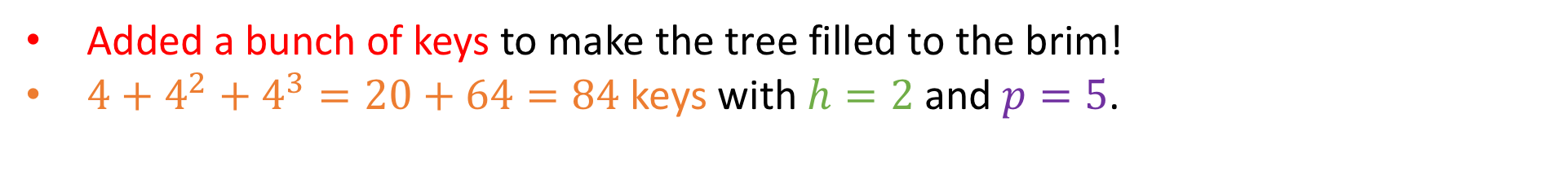
Example #7: Worst-case, splitting the root
57, 90, 162, 190
-3, 6, 11, 34
65, 70, 80, 85
168, 174, 180, 185
200, 240, 260, 282
100, 110, 120, 150
103, 104, 108, 109
181, 182, 183, 184
194, 196, 197, 199
191, 211, 220, 230
210, 211, 220, 230
245, 247, 249, 255
261, 264, 270, 271
283, 290, 291, 294
-9, -6,
-5, 0
1, 3,
4,
5
7, 8, 9, 10
12, 29, 31, 32
39, 40, 52, 56
58, 59, 61, 62
66, 67, 68, 69
72, 74, 75, 78
81, 82, 83, 84
86, 87, 88, 89
92, 93, 94 98
112, 114, 116, 118
124, 128, 130, 132,
152, 154, 157, 160,
164
165, 166, 167,
170, 171,
172,
173
176, 177, 178, 179
Added a bunch of keys to make the tree filled to the brim!
$4+4^{2}+4^{3}=20+64=84$ keys with $h=2$ and $p=5$.

Slide 75
Example #7: Worst-case, splitting the root
57, 90, 162, 190
-3, 6, 11, 34
65, 70, 80, 85
168, 174, 180, 185
200, 240, 260, 282
100, 110, 120, 150
103, 104, 108, 109
181, 182, 183, 184
194, 196, 197, 199
191, 211, 220, 230
210, 211, 220, 230
245, 247, 249, 255
261, 264, 270, 271
283, 290, 291, 294
-9, -6,
-5, 0
1, 3,
4,
5
7, 8, 9, 10
12, 29, 31, 32
39, 40, 52, 56
58, 59, 61, 62
66, 67, 68, 69
72, 74, 75, 78
81, 82, 83, 84
86, 87, 88, 89
92, 93, 94 98
112, 114, 116, 118
124, 128, 130, 132,
152, 154, 157, 160,
164
165, 166, 167,
170, 171,
172,
173
176, 177, 178, 179
Task: Insert 101

Slide 76
Example #7: Worst-case, splitting the root
57, 90, 162, 190
-3, 6, 11, 34
65, 70, 80, 85
168, 174, 180, 185
200, 240, 260, 282
100, 110, 120, 150
101, 103, 104, 108, 109
181, 182, 183, 184
194, 196, 197, 199
191, 211, 220, 230
210, 211, 220, 230
245, 247, 249, 255
261, 264, 270, 271
283, 290, 291, 294
-9, -6,
-5, 0
1, 3,
4,
5
7, 8, 9, 10
12, 29, 31, 32
39, 40, 52, 56
58, 59, 61, 62
66, 67, 68, 69
72, 74, 75, 78
81, 82, 83, 84
86, 87, 88, 89
92, 93, 94 98
112, 114, 116, 118
124, 128, 130, 132,
152, 154, 157, 160,
164
165, 166, 167,
170, 171,
172,
173
176, 177, 178, 179
Task: Insert 101
Overflow ☹

Slide 77

Example #7: Worst-case, splitting the root
57, 90, 162, 190
-3, 6, 11, 34
65, 70, 80, 85
168, 174, 180, 185
200, 240, 260, 282
100, 110, 120, 150
101, 103, 104, 108, 109
181, 182, 183, 184
194, 196, 197, 199
191, 211, 220, 230
210, 211, 220, 230
245, 247, 249, 255
261, 264, 270, 271
283, 290, 291, 294
-9, -6,
-5, 0
1, 3,
4,
5
7, 8, 9, 10
12, 29, 31, 32
39, 40, 52, 56
58, 59, 61, 62
66, 67, 68, 69
72, 74, 75, 78
81, 82, 83, 84
86, 87, 88, 89
92, 93, 94 98
112, 114, 116, 118
124, 128, 130, 132,
152, 154, 157, 160,
164
165, 166, 167,
170, 171,
172,
173
176, 177, 178, 179
Task: Insert 101
Overflow ☹
No possible key rotation to siblings! ☹

Slide 78

Example #7: Worst-case, splitting the root
57, 90, 162, 190
-3, 6, 11, 34
65, 70, 80, 85
168, 174, 180, 185
200, 240, 260, 282
100, 104, 110, 120, 150
181, 182, 183, 184
194, 196, 197, 199
191, 211, 220, 230
210, 211, 220, 230
245, 247, 249, 255
261, 264, 270, 271
283, 290, 291, 294
-9, -6,
-5, 0
1, 3,
4,
5
7, 8, 9, 10
12, 29, 31, 32
39, 40, 52, 56
58, 59, 61, 62
66, 67, 68, 69
72, 74, 75, 78
81, 82, 83, 84
86, 87, 88, 89
92, 93, 94 98
112, 114, 116, 118
124, 128, 130, 132,
152, 154, 157, 160,
164
165, 166, 167,
170, 171,
172,
173
176, 177, 178, 179
101, 103,
101, 103, 104, 108, 109
Task: Insert 101
Overflow ☹
No possible key rotation anywhere in the tree! ☹
Split and elevate 104 (middle key) to parent…

Slide 79

Example #7: Worst-case, splitting the root
57, 90, 162, 190
-3, 6, 11, 34
65, 70, 80, 85
168, 174, 180, 185
200, 240, 260, 282
100, 104, 110, 120, 150
181, 182, 183, 184
194, 196, 197, 199
191, 211, 220, 230
210, 211, 220, 230
245, 247, 249, 255
261, 264, 270, 271
283, 290, 291, 294
-9, -6,
-5, 0
1, 3,
4,
5
7, 8, 9, 10
12, 29, 31, 32
39, 40, 52, 56
58, 59, 61, 62
66, 67, 68, 69
72, 74, 75, 78
81, 82, 83, 84
86, 87, 88, 89
92, 93, 94 98
112, 114, 116, 118
124, 128, 130, 132,
152, 154, 157, 160,
164
165, 166, 167,
170, 171,
172,
173
176, 177, 178, 179
101, 103,
108, 109
Task: Insert 101
Overflow ☹
No possible key rotation anywhere in the tree! ☹
Split and elevate 104 (middle key) to parent…
Which also overflows!

Slide 80

Example #7: Worst-case, splitting the root
57, 90, 162, 190
-3, 6, 11, 34
65, 70, 80, 85
168, 174, 180, 185
200, 240, 260, 282
100, 104, 110, 120, 150
181, 182, 183, 184
194, 196, 197, 199
191, 211, 220, 230
210, 211, 220, 230
245, 247, 249, 255
261, 264, 270, 271
283, 290, 291, 294
-9, -6,
-5, 0
1, 3,
4,
5
7, 8, 9, 10
12, 29, 31, 32
39, 40, 52, 56
58, 59, 61, 62
66, 67, 68, 69
72, 74, 75, 78
81, 82, 83, 84
86, 87, 88, 89
92, 93, 94 98
112, 114, 116, 118
124, 128, 130, 132,
152, 154, 157, 160,
164
165, 166, 167,
170, 171,
172,
173
176, 177, 178, 179
101, 103,
108, 109
Task: Insert 101
Overflow ☹
No possible key rotation anywhere in the tree! ☹
Split and elevate 104 (middle key) to parent…
Which also overflows!
AND ITS OWN SIBLINGS CAN’T HELP WITH ROTATIONS!

Slide 81

Example #7: Worst-case, splitting the root
57, 90, 110 162, 190
-3, 6, 11, 34
65, 70, 80, 85
120, 150
168, 174, 180, 185
200, 240, 260, 282
100, 104
181, 182, 183, 184
194, 196, 197, 199
191, 211, 220, 230
210, 211, 220, 230
245, 247, 249, 255
261, 264, 270, 271
283, 290, 291, 294
-9, -6,
-5, 0
1, 3,
4,
5
7, 8, 9, 10
12, 29, 31, 32
39, 40, 52, 56
58, 59, 61, 62
66, 67, 68, 69
72, 74, 75, 78
81, 82, 83, 84
86, 87, 88, 89
92, 93, 94 98
112, 114, 116, 118
124, 128, 130, 132,
152, 154, 157, 160,
164
165, 166, 167,
170, 171,
172,
173
176, 177, 178, 179
101, 103,
108, 109
Task: Insert 101
Overflow ☹
No possible key rotation anywhere in the tree! ☹
Split and elevate 104 (middle key) to parent…
Which also overflows!
AND ITS OWN SIBLINGS CAN’T HELP WITH ROTATIONS!
Split current node and elevate 110 (middle key) to the parent (the root).

Slide 82

Example #7: Worst-case, splitting the root
57, 90, 110 162, 190
-3, 6, 11, 34
65, 70, 80, 85
120, 150
168, 174, 180, 185
200, 240, 260, 282
100, 104
181, 182, 183, 184
194, 196, 197, 199
191, 211, 220, 230
210, 211, 220, 230
245, 247, 249, 255
261, 264, 270, 271
283, 290, 291, 294
-9, -6,
-5, 0
1, 3,
4,
5
7, 8, 9, 10
12, 29, 31, 32
39, 40, 52, 56
58, 59, 61, 62
66, 67, 68, 69
72, 74, 75, 78
81, 82, 83, 84
86, 87, 88, 89
92, 93, 94 98
112, 114, 116, 118
124, 128, 130, 132,
152, 154, 157, 160,
164
165, 166, 167,
170, 171,
172,
173
176, 177, 178, 179
101, 103,
108, 109
OVERFLOW AGAIN!!!!!!
Task: Insert 101
Overflow ☹
No possible key rotation anywhere in the tree! ☹
Split and elevate 104 (middle key) to parent…
Which also overflows!
AND ITS OWN SIBLINGS CAN’T HELP WITH ROTATIONS!
Split current node and elevate 110 (middle key) to the parent (the root).

Slide 83

Example #7: Worst-case, splitting the root
…..
…..
57, 90, 110 162, 190
-3, 6, 11, 34
65, 70, 80, 85
120, 150
168, 174, 180, 185
200, 240, 260, 282
100, 104
181, 182, 183, 184
194, 196, 197, 199
191, 211, 220, 230
210, 211, 220, 230
245, 247, 249, 255
261, 264, 270, 271
283, 290, 291, 294
-9, -6,
-5, 0
1, 3,
4,
5
7, 8, 9, 10
12, 29, 31, 32
39, 40, 52, 56
58, 59, 61, 62
66, 67, 68, 69
72, 74, 75, 78
81, 82, 83, 84
86, 87, 88, 89
92, 93, 94 98
112, 114, 116, 118
124, 128, 130, 132,
152, 154, 157, 160,
164
165, 166, 167,
170, 171,
172,
173
176, 177, 178, 179
101, 103,
108, 109
OVERFLOW AGAIN!!!!!!
Task: Insert 101
Overflow ☹
No possible key rotation anywhere in the tree! ☹
Split and elevate 104 (middle key) to parent…
Which also overflows!
AND ITS OWN SIBLINGS CAN’T HELP WITH ROTATIONS!
Split current node and elevate 110 (middle key) to the parent (the root).
NO SIBLINGS TO ROTATE TO!

Slide 84
Example #7: Worst-case, splitting the root
110
57, 90,
162, 190,
-3, 6, 11, 34
65, 70, 80, 85
120, 150
168, 174, 180, 185
200, 240, 260, 282
100, 104
181, 182, 183, 184
194, 196, 197, 199
191, 211, 220, 230
210, 211, 220, 230
245, 247, 249, 255
261, 264, 270, 271
283, 290, 291, 294
-9, -6,
-5, 0
1, 3,
4,
5
7, 8, 9, 10
12, 29, 31, 32
39, 40, 52, 56
58, 59, 61, 62
66, 67, 68, 69
72, 74, 75, 78
81, 82, 83, 84
86, 87, 88, 89
92, 93, 94 98
112, 114, 116, 118
124, 128, 130, 132,
152, 154, 157, 160,
164
165, 166, 167,
170, 171,
172,
173
176, 177, 178, 179
101, 103,
108, 109
Task: Insert 101
Overflow ☹
No possible key rotation anywhere in the tree! ☹
Split and elevate 104 (middle key) to parent…
Which also overflows!
AND ITS OWN SIBLINGS CAN’T HELP WITH ROTATIONS!
Split current node and elevate 110 (middle key) to the parent (the root).
SPLIT ROOT, ELEVATING 110, AND DONE.

Slide 85
Dealing with underflows
Since deleting any key will always boil down to deleting some key from the leaf level, underflows can only occur at the leaf level

Slide 86
Dealing with underflows
Since deleting any key will always boil down to deleting some key from the leaf level, underflows can only occur at the leaf level
We will once again attempt key rotations first.

Slide 87
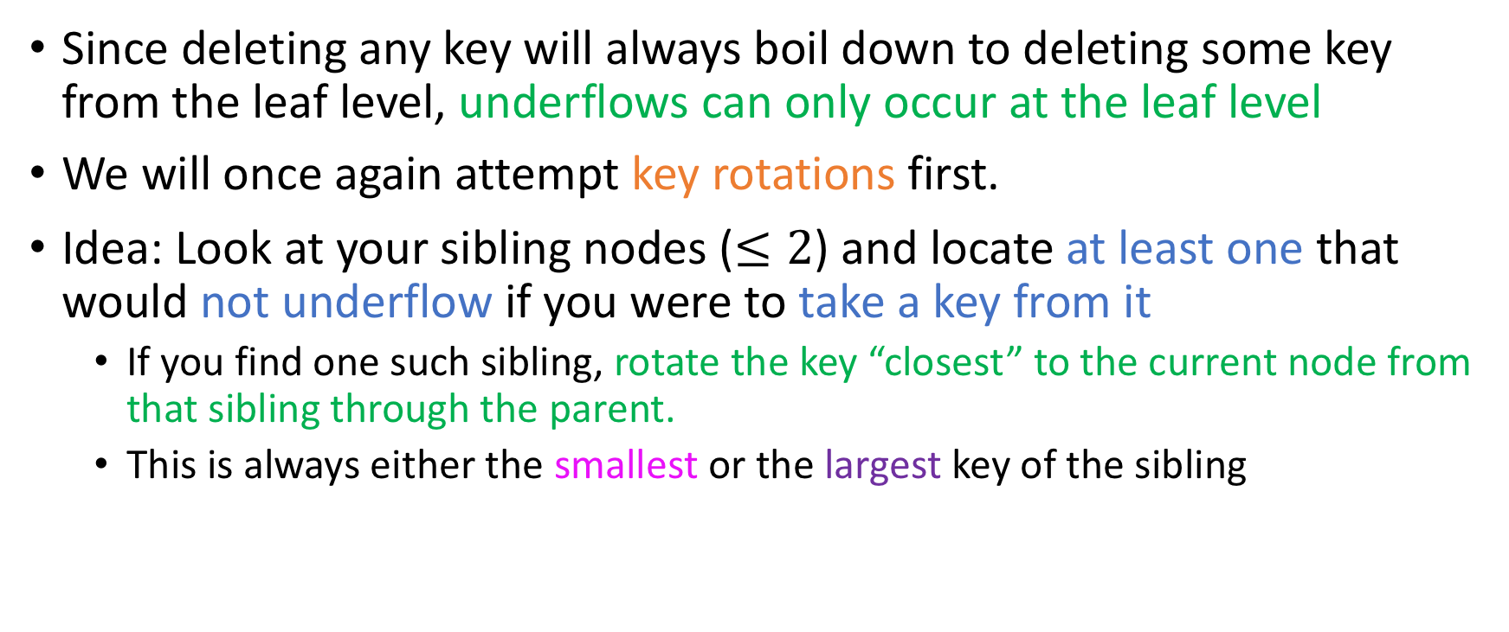
Dealing with underflows
Since deleting any key will always boil down to deleting some key from the leaf level, underflows can only occur at the leaf level
We will once again attempt key rotations first.
Idea: Look at your sibling nodes ($≤2$) and locate at least one that would not underflow if you were to take a key from it
If you find one such sibling, rotate the key “closest” to the current node from that sibling through the parent.
This is always either the smallest or the largest key of the sibling

Slide 88
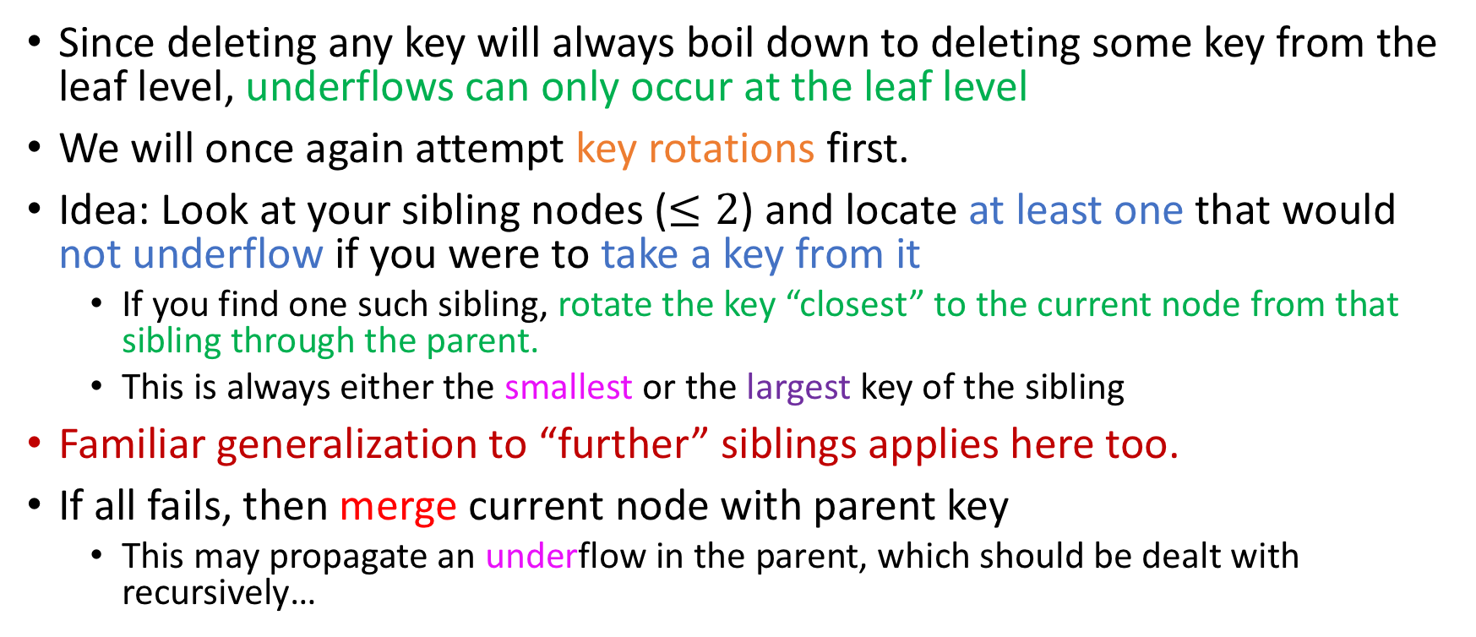
Dealing with underflows
Since deleting any key will always boil down to deleting some key from the leaf level, underflows can only occur at the leaf level
We will once again attempt key rotations first.
Idea: Look at your sibling nodes ($≤2$) and locate at least one that would not underflow if you were to take a key from it
If you find one such sibling, rotate the key “closest” to the current node from that sibling through the parent.
This is always either the smallest or the largest key of the sibling
Familiar generalization to “further” siblings applies here too.
If all fails, then merge current node with parent key
This may propagate an underflow in the parent, which should be dealt with recursively…

Slide 89
Example #0: Leaf deletion, no underflows
57, 90, 162
-5, 6, 10, 34
60, 65, 70
100, 110, 120
179, 210, 300
-9, -6
-3, 0
8, 9
12, 29
39, 40, 50
58, 59
62, 63, 64
66, 67
73,83, 88
92, 98
103, 108, 109
112, 114
124, 150
164, 168, 170, 176
185, 196
220, 240
314, 350, 400
Task: delete 62

Slide 90
Example #0: Leaf deletion, no underflows
57, 90, 162
-5, 6, 10, 34
60, 65, 70
100, 110, 120
179, 210, 300
-9, -6
-3, 0
8, 9
12, 29
39, 40, 50
58, 59
62, 63, 64
66, 67
73,83, 88
92, 98
103, 108, 109
112, 114
124, 150
164, 168, 170, 176
185, 196
220, 240
314, 350, 400
Task: delete 62

Slide 91
Example #0: Leaf deletion, no underflows
57, 90, 162
-5, 6, 10, 34
60, 65, 70
100, 110, 120
179, 210, 300
-9, -6
-3, 0
8, 9
12, 29
39, 40, 50
58, 59
62, 63, 64
66, 67
73,83, 88
92, 98
103, 108, 109
112, 114
124, 150
164, 168, 170, 176
185, 196
220, 240
314, 350, 400
Task: delete 62

Slide 92
Example #0: Leaf deletion, no underflows
57, 90, 162
-5, 6, 10, 34
60, 65, 70
100, 110, 120
179, 210, 300
-9, -6
-3, 0
8, 9
12, 29
39, 40, 50
58, 59
62, 63, 64
66, 67
73,83, 88
92, 98
103, 108, 109
112, 114
124, 150
164, 168, 170, 176
185, 196
220, 240
314, 350, 400
Task: delete 62

Slide 93
Example #0: Leaf deletion, no underflows
57, 90, 162
-5, 6, 10, 34
60, 65, 70
100, 110, 120
179, 210, 300
-9, -6
-3, 0
8, 9
12, 29
39, 40, 50
58, 59
62, 63, 64
66, 67
73,83, 88
92, 98
103, 108, 109
112, 114
124, 150
164, 168, 170, 176
185, 196
220, 240
314, 350, 400
Task: delete 62

Slide 94
Example #0: Leaf deletion, no underflows
57, 90, 162
-5, 6, 10, 34
60, 65, 70
100, 110, 120
179, 210, 300
-9, -6
-3, 0
8, 9
12, 29
39, 40, 50
58, 59
62, 63, 64
66, 67
73,83, 88
92, 98
103, 108, 109
112, 114
124, 150
164, 168, 170, 176
185, 196
220, 240
314, 350, 400
Task: delete 62

Slide 95
Example #0: Leaf deletion, no underflows
57, 90, 162
-5, 6, 10, 34
60, 65, 70
100, 110, 120
179, 210, 300
-9, -6
-3, 0
8, 9
12, 29
39, 40, 50
58, 59
62, 63, 64
66, 67
73,83, 88
92, 98
103, 108, 109
112, 114
124, 150
164, 168, 170, 176
185, 196
220, 240
314, 350, 400
Task: delete 62

Slide 96
Example #0: Leaf deletion, no underflows
57, 90, 162
-5, 6, 10, 34
60, 65, 70
100, 110, 120
179, 210, 300
-9, -6
-3, 0
8, 9
12, 29
39, 40, 50
58, 59
62, 63, 64
66, 67
73,83, 88
92, 98
103, 108, 109
112, 114
124, 150
164, 168, 170, 176
185, 196
220, 240
314, 350, 400
Task: delete 62

Slide 97
Example #0: Leaf deletion, no underflows
57, 90, 162
-5, 6, 10, 34
60, 65, 70
100, 110, 120
179, 210, 300
-9, -6
-3, 0
8, 9
12, 29
39, 40, 50
58, 59
62, 63, 64
66, 67
73,83, 88
92, 98
103, 108, 109
112, 114
124, 150
164, 168, 170, 176
185, 196
220, 240
314, 350, 400
Task: delete 62

Slide 98
Example #0: Leaf deletion, no underflows
57, 90, 162
-5, 6, 10, 34
60, 65, 70
100, 110, 120
179, 210, 300
-9, -6
-3, 0
8, 9
12, 29
39, 40, 50
58, 59
,63, 64
66, 67
73,83, 88
92, 98
103, 108, 109
112, 114
124, 150
164, 168, 170, 176
185, 196
220, 240
314, 350, 400
Task: delete 62

Slide 99
Example #1: Inner node deletion, no underflows
57, 90, 162
-5, 6, 10, 34
60, 65, 70
100, 110, 120
179, 210, 300
-9, -6
-3, 0
8, 9
12, 29
39, 40, 50
58, 59
63, 64
66, 67
73,83, 88
92, 98
103, 108, 109
112, 114
124, 150
164, 168, 170, 176
185, 196
220, 240
314, 350, 400
Task: delete 34

Slide 100
Example #1: Inner node deletion, no underflows
57, 90, 162
-5, 6, 10, 34
60, 65, 70
100, 110, 120
179, 210, 300
-9, -6
-3, 0
8, 9
12, 29
39, 40, 50
58, 59
63, 64
66, 67
73,83, 88
92, 98
103, 108, 109
112, 114
124, 150
164, 168, 170, 176
185, 196
220, 240
314, 350, 400
Task: delete 34

Slide 101
Example #1: Inner node deletion, no underflows
57, 90, 162
-5, 6, 10, 34
60, 65, 70
100, 110, 120
179, 210, 300
-9, -6
-3, 0
8, 9
12, 29
39, 40, 50
58, 59
63, 64
66, 67
73,83, 88
92, 98
103, 108, 109
112, 114
124, 150
164, 168, 170, 176
185, 196
220, 240
314, 350, 400
Task: delete 34

Slide 102
Example #1: Inner node deletion, no underflows
57, 90, 162
-5, 6, 10, 34
60, 65, 70
100, 110, 120
179, 210, 300
-9, -6
-3, 0
8, 9
12, 29
39, 40, 50
58, 59
63, 64
66, 67
73,83, 88
92, 98
103, 108, 109
112, 114
124, 150
164, 168, 170, 176
185, 196
220, 240
314, 350, 400
Task: delete 34

Slide 103
Example #1: Inner node deletion, no underflows
57, 90, 162
-5, 6, 10, 34
60, 65, 70
100, 110, 120
179, 210, 300
-9, -6
-3, 0
8, 9
12, 29
39, 40, 50
58, 59
63, 64
66, 67
73,83, 88
92, 98
103, 108, 109
112, 114
124, 150
164, 168, 170, 176
185, 196
220, 240
314, 350, 400
Task: delete 34

Slide 104
Example #1: Inner node deletion, no underflows
57, 90, 162
-5, 6, 10, 34
60, 65, 70
100, 110, 120
179, 210, 300
-9, -6
-3, 0
8, 9
12, 29
39, 40, 50
58, 59
63, 64
66, 67
73,83, 88
92, 98
103, 108, 109
112, 114
124, 150
164, 168, 170, 176
185, 196
220, 240
314, 350, 400
Task: delete 34

Slide 105
Example #1: Inner node deletion, no underflows
57, 90, 162
-5, 6, 10, 34
60, 65, 70
100, 110, 120
179, 210, 300
-9, -6
-3, 0
8, 9
12, 29
39, 40, 50
58, 59
63, 64
66, 67
73,83, 88
92, 98
103, 108, 109
112, 114
124, 150
164, 168, 170, 176
185, 196
220, 240
314, 350, 400
Task: delete 34
Finding inorder successor…

Slide 106
Example #1: Inner node deletion, no underflows
57, 90, 162
-5, 6, 10, 34
60, 65, 70
100, 110, 120
179, 210, 300
-9, -6
-3, 0
8, 9
12, 29
39, 40, 50
58, 59
63, 64
66, 67
73,83, 88
92, 98
103, 108, 109
112, 114
124, 150
164, 168, 170, 176
185, 196
220, 240
314, 350, 400
Task: delete 34
Finding inorder successor…

Slide 107
Example #1: Inner node deletion, no underflows
57, 90, 162
-5, 6, 10, 39
60, 65, 70
100, 110, 120
179, 210, 300
-9, -6
-3, 0
8, 9
12, 29
39, 40, 50
58, 59
63, 64
66, 67
73,83, 88
92, 98
103, 108, 109
112, 114
124, 150
164, 168, 170, 176
185, 196
220, 240
314, 350, 400
Task: delete 34
Finding inorder successor…
Copy key

Slide 108
Example #1: Inner node deletion, no underflows
57, 90, 162
-5, 6, 10, 39
60, 65, 70
100, 110, 120
179, 210, 300
-9, -6
-3, 0
8, 9
12, 29
39, 40, 50
58, 59
63, 64
66, 67
73,83, 88
92, 98
103, 108, 109
112, 114
124, 150
164, 168, 170, 176
185, 196
220, 240
314, 350, 400
Task: delete 34
Finding inorder successor…
Copy key
Recursively delete 39

Slide 109

Example #1: Inner node deletion, no underflows
57, 90, 162
-5, 6, 10, 39
60, 65, 70
100, 110, 120
179, 210, 300
-9, -6
-3, 0
8, 9
12, 29
40, 50
58, 59
63, 64
66, 67
73,83, 88
92, 98
103, 108, 109
112, 114
124, 150
164, 168, 170, 176
185, 196
220, 240
314, 350, 400
Task: delete 34
Finding inorder successor…
Copy key
Recursively delete 39
No underflow, no problem!

Slide 110
Example #2: Key rotation
57, 90, 162
-5, 6, 10, 39
60, 65, 70
100, 110, 120
179, 210, 300
-9, -6
-3, 0
8, 9
12, 29
40, 50
58, 59
63, 64
66, 67
73,83, 88
92, 98
103, 108, 109
112, 114
124, 150
164, 168, 170, 176
185, 196
220, 240
314, 350, 400
Task: delete 112

Slide 111
Example #2: Key rotation
57, 90, 162
-5, 6, 10, 39
60, 65, 70
100, 110, 120
179, 210, 300
-9, -6
-3, 0
8, 9
12, 29
40, 50
58, 59
63, 64
66, 67
73,83, 88
92, 98
103, 108, 109
112, 114
124, 150
164, 168, 170, 176
185, 196
220, 240
314, 350, 400
Task: delete 112

Slide 112
Example #2: Key rotation
57, 90, 162
-5, 6, 10, 39
60, 65, 70
100, 110, 120
179, 210, 300
-9, -6
-3, 0
8, 9
12, 29
40, 50
58, 59
63, 64
66, 67
73,83, 88
92, 98
103, 108, 109
114
124, 150
164, 168, 170, 176
185, 196
220, 240
314, 350, 400
Task: delete 112
Underflow ☹

Slide 113
Example #2: Key rotation
57, 90, 162
-5, 6, 10, 39
60, 65, 70
100, 110, 120
179, 210, 300
-9, -6
-3, 0
8, 9
12, 29
40, 50
58, 59
63, 64
66, 67
73,83, 88
92, 98
103, 108, 109
114
124, 150
164, 168, 170, 176
185, 196
220, 240
314, 350, 400
Task: delete 112
Underflow ☹
Solvable via key rotation ☺

Slide 114
Example #2: Key rotation
57, 90, 162
-5, 6, 10, 39
60, 65, 70
100, 109, 120
179, 210, 300
-9, -6
-3, 0
8, 9
12, 29
40, 50
58, 59
63, 64
66, 67
73,83, 88
92, 98
103, 108,
110, 114
124, 150
164, 168, 170, 176
185, 196
220, 240
314, 350, 400
Task: delete 112
Underflow ☹
Solvable via key rotation ☺

Slide 115
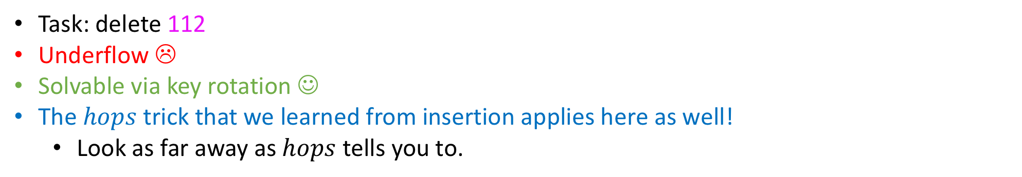
Example #2: Key rotation
57, 90, 162
-5, 6, 10, 39
60, 65, 70
100, 109, 120
179, 210, 300
-9, -6
-3, 0
8, 9
12, 29
40, 50
58, 59
63, 64
66, 67
73,83, 88
92, 98
103, 108,
110, 114
124, 150
164, 168, 170, 176
185, 196
220, 240
314, 350, 400
Task: delete 112
Underflow ☹
Solvable via key rotation ☺
The $hops$ trick that we learned from insertion applies here as well!
Look as far away as $hops$ tells you to.

Slide 116
Example #3: Merging with sibling node
57, 90, 162
-5, 6, 10, 39
60, 65, 70
100, 109, 120
179, 210, 300
-9, -6
-3, 0
8, 9
12, 29
40, 50
58, 59
63, 64
66, 67
73,83, 88
92, 98
103, 108
110, 114
124, 150
164, 168, 170, 176
185, 196
220, 240
314, 350, 400
Task: delete 50

Slide 117
Example #3: Merging with sibling node
57, 90, 162
-5, 6, 10, 39
60, 65, 70
100, 109, 120
179, 210, 300
-9, -6
-3, 0
8, 9
12, 29
40, 50
58, 59
63, 64
66, 67
73,83, 88
92, 98
103, 108
110, 114
124, 150
164, 168, 170, 176
185, 196
220, 240
314, 350, 400
Task: delete 50

Slide 118
Example #3: Merging with sibling node
57, 90, 162
-5, 6, 10, 39
60, 65, 70
100, 109, 120
179, 210, 300
-9, -6
-3, 0
8, 9
12, 29
40
58, 59
63, 64
66, 67
73,83, 88
92, 98
103, 108
110, 114
124, 150
164, 168, 170, 176
185, 196
220, 240
314, 350, 400
Task: delete 50
Underflow ☹

Slide 119
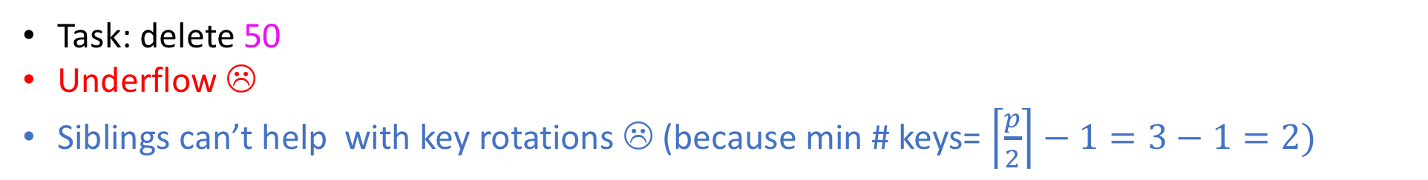
Example #3: Merging with sibling node
57, 90, 162
-5, 6, 10, 39
60, 65, 70
100, 109, 120
179, 210, 300
-9, -6
-3, 0
8, 9
12, 29
40
58, 59
63, 64
66, 67
73,83, 88
92, 98
103, 108
110, 114
124, 150
164, 168, 170, 176
185, 196
220, 240
314, 350, 400
Task: delete 50
Underflow ☹
Siblings can’t help with key rotations ☹ (because min # keys= $\left\lceil \frac{p}{2}\right\rceil −1=3−1=2)$

Slide 120
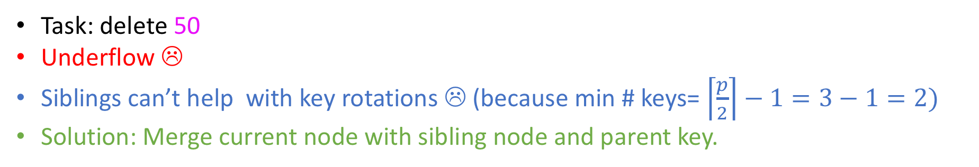
Example #3: Merging with sibling node
57, 90, 162
-5, 6, 10, 39
60, 65, 70
100, 109, 120
179, 210, 300
-9, -6
-3, 0
8, 9
12, 29
40
58, 59
63, 64
66, 67
73,83, 88
92, 98
103, 108
110, 114
124, 150
164, 168, 170, 176
185, 196
220, 240
314, 350, 400
Task: delete 50
Underflow ☹
Siblings can’t help with key rotations ☹ (because min # keys= $\left\lceil \frac{p}{2}\right\rceil −1=3−1=2)$
Solution: Merge current node with sibling node and parent key.

Slide 121
Example #3: Merging with parent node
57, 90, 162
-5, 6, 10
60, 65, 70
100, 109, 120
179, 210, 300
-9, -6
-3, 0
8, 9
12, 29, 39,40
58, 59
63, 64
66, 67
73,83, 88
92, 98
103, 108
110, 114
124, 150
164, 168, 170, 176
185, 196
220, 240
314, 350, 400
Task: delete 50
Underflow ☹
Siblings can’t help with key rotations ☹ (because min # keys= $\left\lceil \frac{p}{2}\right\rceil −1=3−1=2)$
Solution: Merge current node with sibling node and parent key.

Slide 122
Example #4: Merging with either sibling
57, 90, 162
-5, 6, 10
60, 65, 70
100, 109, 120
179, 210, 300
-9, -6
-3, 0
8, 9
12, 29, 39,40
58, 59
63, 64
66, 67
73,83, 88
92, 98
103, 108
110, 114
124, 150
164, 168, 170, 176
185, 196
220, 240
314, 350, 400
Task: delete 108

Slide 123
Example #4: Merging with either sibling
57, 90, 162
-5, 6, 10
60, 65, 70
100, 109, 120
179, 210, 300
-9, -6
-3, 0
8, 9
12, 29, 39,40
58, 59
63, 64
66, 67
73,83, 88
92, 98
103, 108
110, 114
124, 150
164, 168, 170, 176
185, 196
220, 240
314, 350, 400
Task: delete 108

Slide 124
Example #4: Merging with either sibling
57, 90, 162
-5, 6, 10
60, 65, 70
100, 109, 120
179, 210, 300
-9, -6
-3, 0
8, 9
12, 29, 39,40
58, 59
63, 64
66, 67
73,83, 88
92, 98
103
110, 114
124, 150
164, 168, 170, 176
185, 196
220, 240
314, 350, 400
Task: delete 108
Underflow ☹

Slide 125
Example #4: Merging with either sibling
57, 90, 162
-5, 6, 10
60, 65, 70
100, 109, 120
179, 210, 300
-9, -6
-3, 0
8, 9
12, 29, 39,40
58, 59
63, 64
66, 67
73,83, 88
92, 98
103
110, 114
124, 150
164, 168, 170, 176
185, 196
220, 240
314, 350, 400
Task: delete 108
Underflow ☹
Siblings can’t help with key rotations ☹ (same reason)

Slide 126
Example #4: Merging with either sibling
57, 90, 162
-5, 6, 10
60, 65, 70
109, 120
179, 210, 300
-9, -6
-3, 0
8, 9
12, 29, 39,40
58, 59
63, 64
66, 67
73,83, 88
92,98,100, 103
110, 114
124, 150
164, 168, 170, 176
185, 196
220, 240
314, 350, 400
Task: delete 108
Underflow ☹
Siblings can’t help with key rotations ☹ (same reason)
A relief force appears in the form of a sibling-parent key merging ☺

Slide 127
Example #5: Merging all the way to the root.
57, 89
-5, 6
60, 65,
109, 120
-9, -6
-3, 0
58, 59
63, 64
66, 67
100, 103
110, 114
124, 150
8, 9
Task: delete 9

Slide 128
Example #5: Merging all the way to the root.
57, 89
-5, 6
60, 65,
109, 120
-9, -6
-3, 0
58, 59
63, 64
66, 67
100, 103
110, 114
124, 150
8, 9
Task: delete 9

Slide 129
Example #5: Merging all the way to the root.
57, 89
-5, 6
60, 65,
109, 120
-9, -6
-3, 0
58, 59
63, 64
66, 67
100, 103
110, 114
124, 150
8
Task: delete 9
Underflow ☹

Slide 130
Example #5: Merging all the way to the root.
57, 89
-5, 6
60, 65,
109, 120
-9, -6
-3, 0
58, 59
63, 64
66, 67
100, 103
110, 114
124, 150
8
Task: delete 9
Underflow ☹
Siblings can’t help with key rotations! ☹

Slide 131
Example #5: Merging all the way to the root.
57, 89
-5
60, 65
109, 120
-9, -6
58, 59
63, 64
66, 67
100, 103
110, 114
124, 150
-3, 0, 6, 8
Task: delete 9
Underflow ☹
Siblings can’t help with key rotations! ☹
Merging with parent key and sibling ☺

Slide 132
Example #5: Merging all the way to the root.
57, 89
-5
60, 65
109, 120
-9, -6
58, 59
63, 64
66, 67
100, 103
110, 114
124, 150
-3, 0, 6, 8
Task: delete 9
Underflow ☹
Siblings can’t help with key rotations! ☹
Merging with parent key and sibling ☺
Parent underflows ☹

Slide 133
Example #5: Merging all the way to the root.
57, 89
-5
60, 65
109, 120
-9, -6
58, 59
63, 64
66, 67
100, 103
110, 114
124, 150
-3, 0, 6, 8
Task: delete 9
Underflow ☹
Siblings can’t help with key rotations! ☹
Merging with parent key and sibling ☺
Parent underflows ☹
Siblings can’t help with rotations☹

Slide 134
Example #5: Merging all the way to the root.
89
-5, 57, 60, 65
109, 120
-9, -6
-3, 0, 6, 8
58, 59
63, 64
66, 67
100, 103
110, 114
124, 150
Task: delete 9
Underflow ☹
Siblings can’t help with key rotations! ☹
Merging with parent key and sibling ☺
Parent underflows ☹
Siblings can’t help with rotations ☹
Solution: Merge with parent key and sibling node! ☺

Slide 135
Example #6: Root underflow
57
-5, 6
60, 65
-9, -6
-3, 0
10, 12
58, 59
63, 64
66, 67
Task: delete 66

Slide 136
Example #6: Root underflow
57
-5, 6
60, 65
-9, -6
-3, 0
10, 12
58, 59
63, 64
67
Task: delete 66
Underflow ☹

Slide 137
Example #6: Root underflow
57
-5, 6
60, 65
-9, -6
-3, 0
10, 12
58, 59
63, 64
67
Task: delete 66
Underflow ☹
Siblings can’t help with key rotations ☹

Slide 138
Example #6: Root underflow
57
-5, 6
60
-9, -6
-3, 0
10, 12
58, 59
63, 64, 65, 67
Task: delete 66
Underflow ☹
Siblings can’t help with key rotations ☹
Merge ☺

Slide 139
Example #6: Root underflow
57
-5, 6
60
-9, -6
-3, 0
10, 12
58, 59
63, 64, 65, 67
Task: delete 66
Underflow ☹
Siblings can’t help with key rotations ☹
Merge ☺
Underflow ☹

Slide 140
Example #6: Root underflow
57
-5, 6
60
-9, -6
-3, 0
10, 12
58, 59
63, 64, 65, 67
Task: delete 66
Underflow ☹
Siblings can’t help with key rotations ☹
Merge ☺
Underflow ☹
Siblings can’t help with key rotations ☹

Slide 141
Example #6: Root underflow
-5, 6, 57, 60
-9, -6
-3, 0
10, 12
58, 59
63, 64, 65, 67
Task: delete 66
Underflow ☹
Siblings can’t help with key rotations ☹
Merge ☺
Underflow ☹
Siblings can’t help with key rotations ☹
Merge ☺

Slide 142
Example #6: Root underflow
-5, 6, 57, 60
-9, -6
-3, 0
10, 12
58, 59
63, 64, 65, 67
Task: delete 66
Underflow ☹
Siblings can’t help with key rotations ☹
Merge ☺
Underflow ☹
Siblings can’t help with key rotations ☹
Merge ☺
Root underflows ☹

Slide 143
Example #6: Root underflow
root
-5, 6, 57, 60
-9, -6
-3, 0
10, 12
58, 59
63, 64, 65, 67
Task: delete 66
Underflow ☹
Siblings can’t help ☹
Merge ☺
Underflow ☹
Siblings can’t help ☹
Merge ☺
Root underflows ☹
Delete it, and set new root to its only child! ☺

Slide 144
Searching a B-Tree
Searching has effectively been covered by presenting insertion and deletion.
At every level, I will query the node via binary search. Either:
I will find the key, so I’m done, or
I will follow the relevant pointer to a subtree, and repeat.
Worse case: I have to go all the way to the leaves.

Slide 145
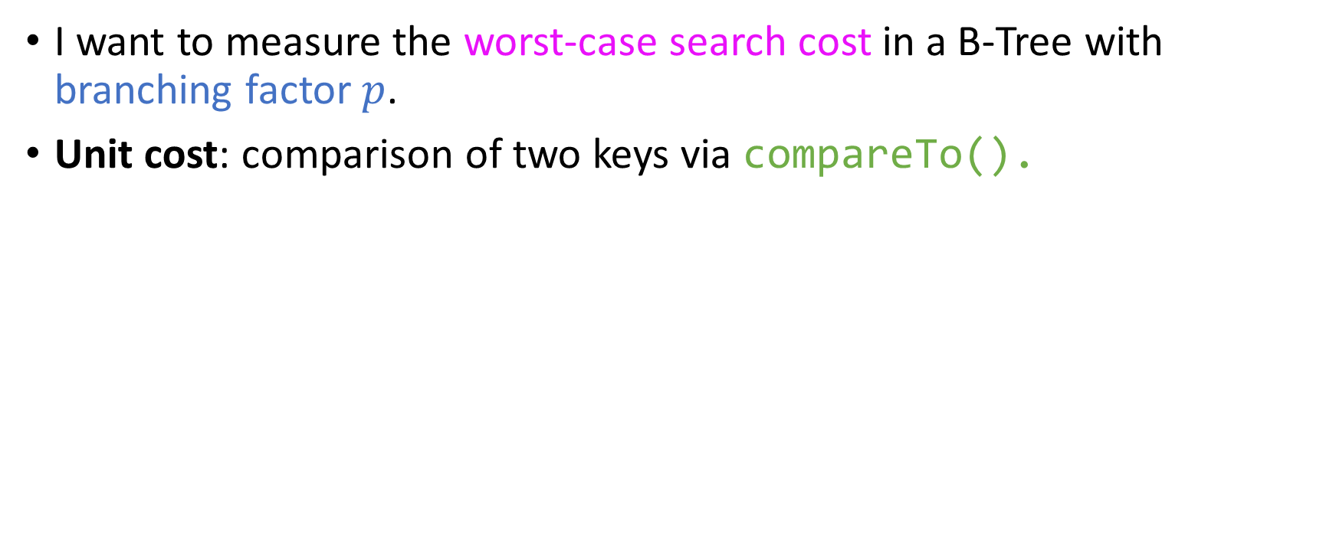
Quiz
I want to measure the worst-case search cost in a B-Tree with branching factor $p$.
Unit cost: comparison of two keys via compareTo().

Slide 146
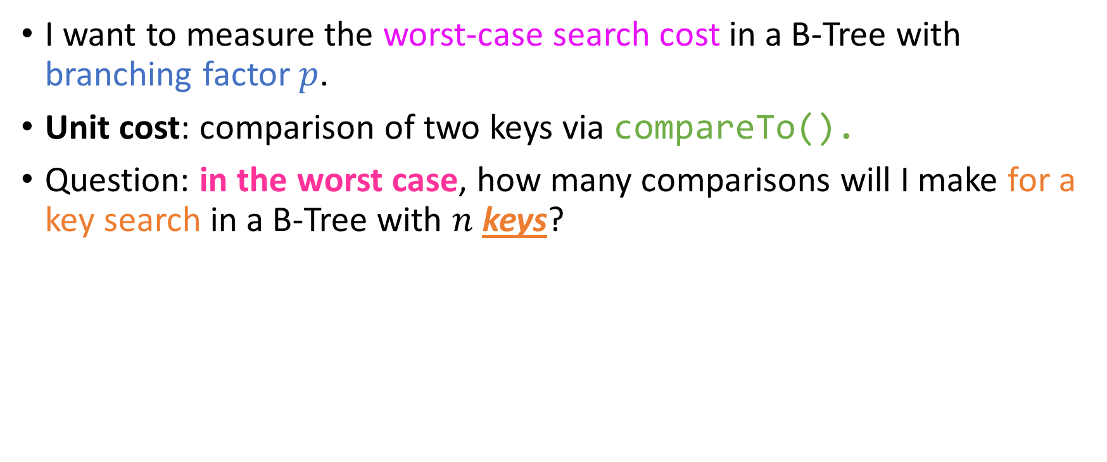
Quiz
I want to measure the worst-case search cost in a B-Tree with branching factor $p$.
Unit cost: comparison of two keys via compareTo().
Question: in the worst case, how many comparisons will I make for a key search in a B-Tree with $n$ keys?

Slide 147
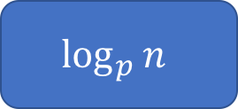
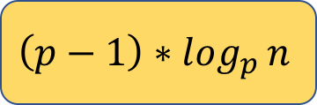
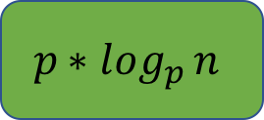
Quiz
I want to measure the worst-case search cost in a B-Tree with branching factor $p$.
Unit cost: comparison of two keys via compareTo().
Question: in the worst case, how many comparisons will I make for a key search in a B-Tree with $n$ keys?
$$\log_{p}{n}$$
$$p{∗log}_{p}{n}$$
$${\left(p−1\right)∗log}_{p}{n}$$
Something else (what?)

Slide 148
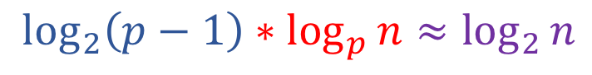
Quiz
I want to measure the worst-case search cost in a B-Tree with branching factor $p$.
Unit cost: comparison of two keys via compareTo().
Question: in the worst case, how many comparisons will I make for a key search in a B-Tree with $n$ keys?
$$\log_{2}\left(p−1\right)∗\log_{p}{n}≈\log_{2}{n}$$
$$\log_{p}{n}$$
$$p{∗log}_{p}{n}$$
$${\left(p−1\right)∗log}_{p}{n}$$
Something else (what?)
With the keys sorted by construction, it really is dumb to not do binary search in every node! ;)

Slide 149

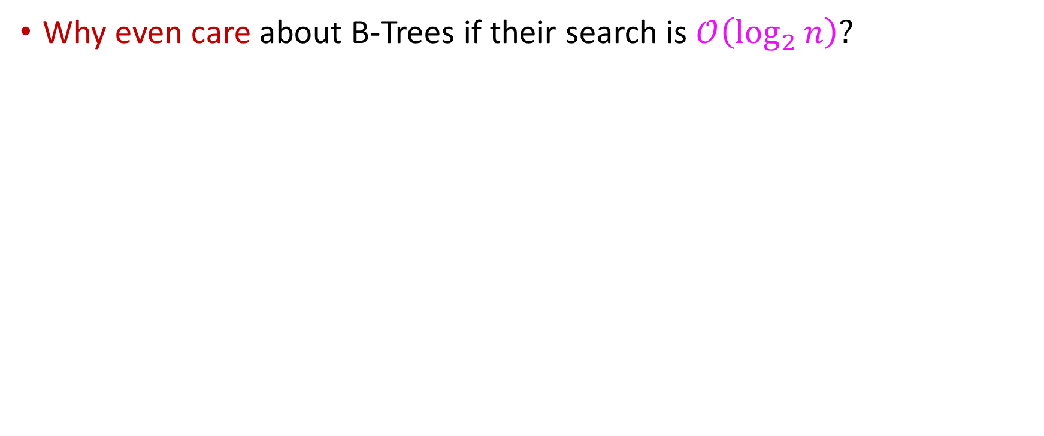
So, why even care?
Why even care about B-Trees if their search is $𝒪\left(\log_{2}{n}\right)?$

Slide 150

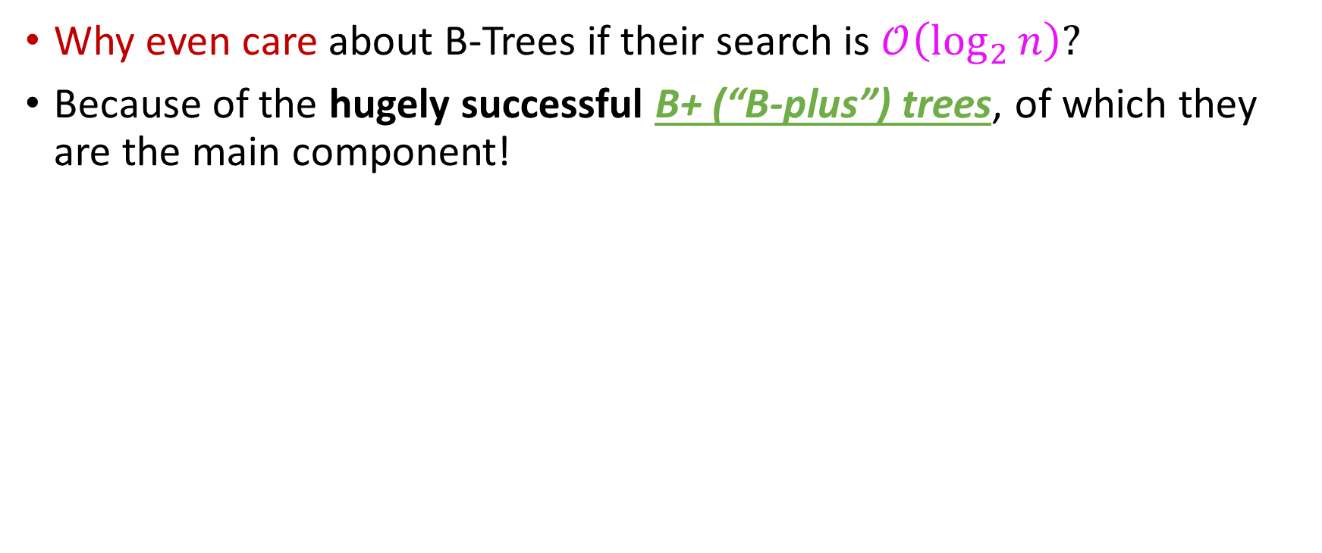
So, why even care?
Why even care about B-Trees if their search is $𝒪\left(\log_{2}{n}\right)?$
Because of the hugely successful B+ (“B-plus”) trees, of which they are the main component!

Slide 151
The components of a B+-tree
A (memory-resident) B-Tree
500.5
* | *
126.5 | 250.5 | 375.5
625.5 | 750.5 | 875.5
* | * | * | *
* | * | * | *

Slide 152
The components of a B+-tree
A (memory-resident) B-Tree
Data on disk
500.5
* | *
126.5 | 250.5 | 375.5
625.5 | 750.5 | 875.5
* | * | * | *
* | * | * | *
0
126
127
250
251
375
376
500
501
625
626
750
751
875
876
1000

Slide 153
The components of a B+-tree
A (memory-resident) B-Tree
Data on disk
These weird-looking pointers on disk
500.5
* | *
126.5 | 250.5 | 375.5
625.5 | 750.5 | 875.5
* | * | * | *
* | * | * | *
0
126
127
250
251
375
376
500
501
625
626
750
751
875
876
1000

Slide 154

The components of a B+-tree
Give us a B⁺-tree (“B – plus tree”) index!
A (memory-resident) B-Tree
Data on disk
These weird-looking pointers on disk
500.5
* | *
126.5 | 250.5 | 375.5
625.5 | 750.5 | 875.5
* | * | * | *
* | * | * | *
0
126
127
250
251
375
376
500
501
625
626
750
751
875
876
1000

Slide 155
Are buffers a good storage choice?
Issue: Static storage buffers for keys and references waste memory space for nodes.
Proposal: Use linked lists instead!
This is actually not a good idea.
Counter-arguments:
Buffers waste space MINIMAL compared to the size of the DB (recall earlier results)
Static buffers allow us to perform super-efficient binary search for seeking keys at every node
In 2019, memory is cheaper than it used to be in 1970; no reason to over-optimize!

Slide 156

Are buffers a good storage idea?
Issue: Static storage buffers for keys and references waste memory space for nodes.
Proposal: Use linked lists instead!
This is actually not a good idea.
Counter-arguments:
Buffers waste space MINIMAL compared to the size of the DB (recall earlier results)
Static buffers allow us to perform super-efficient binary search for seeking keys at every node
In 2019, memory is cheaper than it used to be in 1970;
no reason to over-optimize!
Conclusion: yes, they are an excellent storage choice.

